Slide 1
24
The Digestive System

Slide 2
An Introduction to the Digestive System
Learning Outcomes
  24-1 Identify the organs of the digestive system, list their major functions, describe the functional histology of the digestive tract, and outline the mechanisms that regulate digestion.
  24-2 Discuss the anatomy of the oral cavity, and list the functions of its major structures and regions.
  24-3 Describe the structure and functions of the pharynx.
  24-4 Describe the structure and functions of the esophagus.

Slide 3
An Introduction to the Digestive System
Learning Outcomes
  24-5 Describe the anatomy of the stomach, including its histological features, and discuss its roles in digestion and absorption.
  24-6 Describe the anatomical and histological characteristics of the small intestine, explain the functions and regulation of intestinal secretions, and describe the structure, functions, and regulation of the accessory digestive organs.

Slide 4
An Introduction to the Digestive System
Learning Outcomes
  24-7 Describe the gross and histological structure of the large intestine, including its regional specializations and role in nutrient absorption.
  24-8 List the nutrients required by the body, describe the chemical events responsible for the digestion of organic nutrients, and describe the mechanisms involved in the absorption of organic and inorganic nutrients.

Slide 5
An Introduction to the Digestive System
Learning Outcomes
  24-9 Summarize the effects of aging on the digestive system.
  24-10 Give examples of interactions between the digestive system and other organ systems studied so far.

Slide 6
An Introduction to the Digestive System
The Digestive System
  Acquires nutrients from environment
  Anabolism
    Uses raw materials to synthesize essential compounds
  Catabolism
    Decomposes substances to provide energy cells need to function

Slide 7
An Introduction to the Digestive System
Catabolic Reactions
  Require two essential ingredients
    Oxygen
    Organic molecules broken down by intracellular enzymes
      For example, carbohydrates, fats, and proteins

Slide 8
24-1 The Digestive Tract
The Digestive Tract
  Also called gastrointestinal (GI) tract or alimentary canal
  Is a muscular tube
  Extends from oral cavity to anus
    Passes through pharynx, esophagus, stomach, and small and large intestines

Slide 9
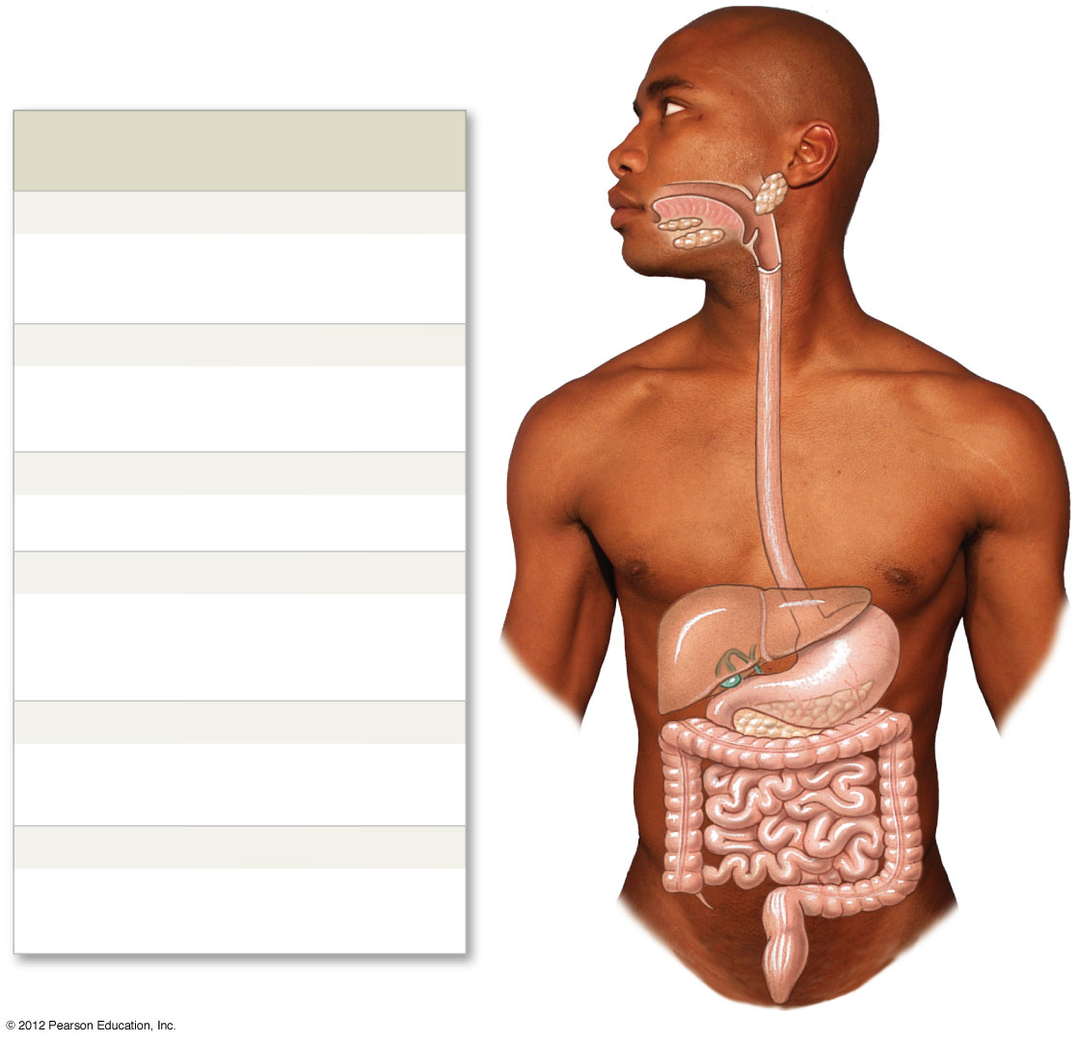
Figure 24-1 The Components of the Digestive System
Major Subdivisions of
the Digestive Tract
Mouth
Oral Cavity, Teeth, Tongue
Mechanical processing, moistening,
mixing with salivary secretions
Pharynx
Muscular propulsion of materials into the
esophagus
Esophagus
Transport of materials to the stomach
Stomach
Chemical breakdown of materials by acid
and enzymes; mechanical processing
through muscular contractions
Small Intestine
Enzymatic digestion and absorption of
water, organic substrates, vitamins, and ions
Large Intestine
Enzymatic digestion and absorption of
water, organic substrates, vitamins, and ions
Anus
Notes:
9

Slide 10
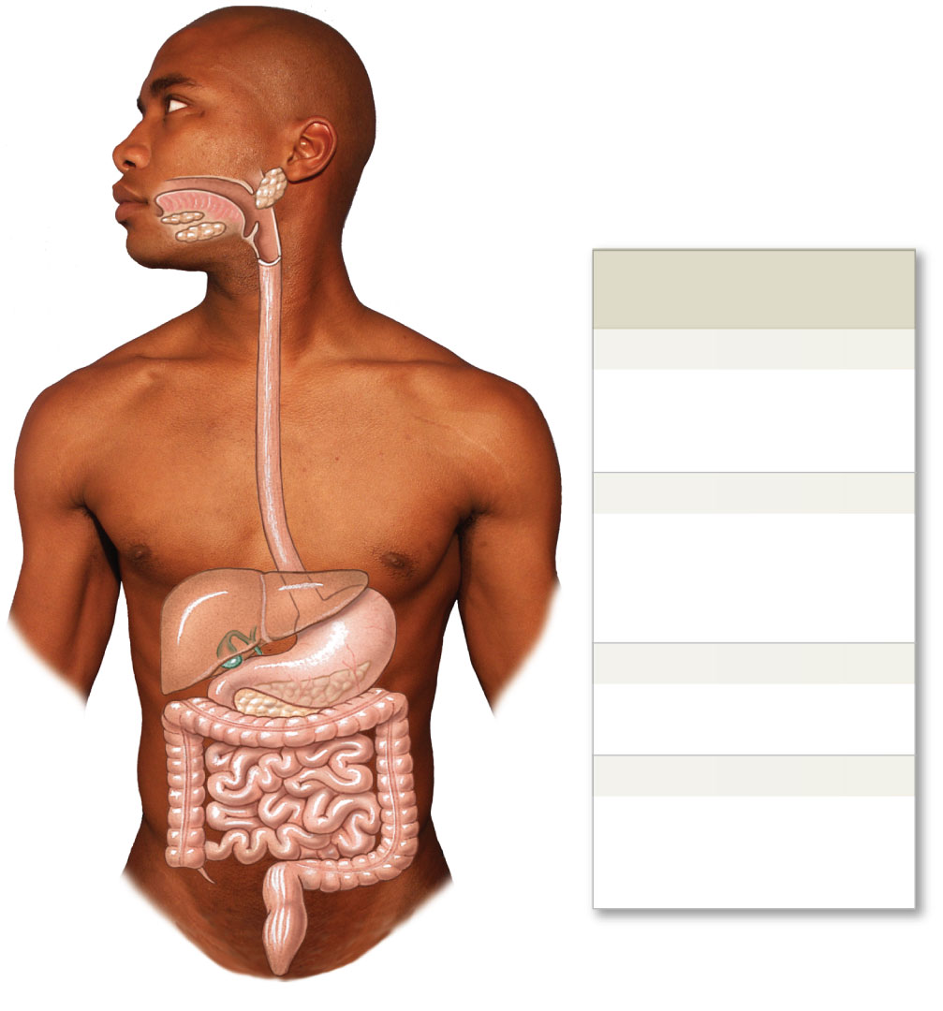
Figure 24-1 The Components of the Digestive System
Accessory Organs of
the Digestive System
Salivary glands
Secretion of lubricating fluid
containing enzymes that
break down carbohydrates
Liver
Secretion of bile (important
for lipid digestion), storage of
nutrients, many other vital
functions
Gallbladder
Storage and concentration of
bile
Pancreas
Exocrine cells secrete buffers
and digestive enzymes;
endocrine cells secrete
hormones
Notes:
10

Slide 11
24-1 The Digestive Tract
Six Functions of the Digestive System
  Ingestion
  Mechanical processing
  Digestion
  Secretion
  Absorption
  Excretion

Slide 12
24-1 The Digestive Tract
Ingestion
  Occurs when materials enter digestive tract via the mouth
Mechanical Processing
  Crushing and shearing
  Makes materials easier to propel along digestive tract
Digestion
  The chemical breakdown of food into small organic fragments for absorption by digestive epithelium

Slide 13
24-1 The Digestive Tract
Secretion
  Is the release of water, acids, enzymes, buffers, and salts
  By epithelium of digestive tract
  By glandular organs

Slide 14
24-1 The Digestive Tract
Absorption
  Movement of organic substrates, electrolytes, vitamins, and water
  Across digestive epithelium
  Into interstitial fluid of digestive tract
Excretion
  Removal of waste products from body fluids
  Process called defecation removes feces

Slide 15
24-1 The Digestive Tract
The Lining of the Digestive Tract
  Safeguards surrounding tissues against:
    Corrosive effects of digestive acids and enzymes
    Mechanical stresses, such as abrasion
    Bacteria either ingested with food or that reside in digestive tract

Slide 16
24-1 The Digestive Tract
The Digestive Organs and the Peritoneum
  Lined with serous membrane consisting of:
    Serosa, or visceral peritoneum
      Covers organs within peritoneal cavity
    Parietal peritoneum
      Lines inner surfaces of body wall

Slide 17
24-1 The Digestive Tract
Peritoneal Fluid
  Is produced by serous membrane lining
  Provides essential lubrication
  Separates parietal and visceral surfaces
  Allows sliding without friction or irritation
  About 7 liters produced and absorbed daily, but very little in peritoneal cavity at one time
    Ascites – excess peritoneal fluid causing abdominal swelling

Slide 18
24-1 The Digestive Tract
Mesenteries
  Are double sheets of peritoneal membrane
    That connect parietal peritoneum
    With visceral peritoneum
  Provides an access route to and from the digestive tract
    For passage of blood vessels, nerves, and lymphatic vessels
  Stabilize positions of attached organs
    Prevent intestines from becoming entangled

Slide 19
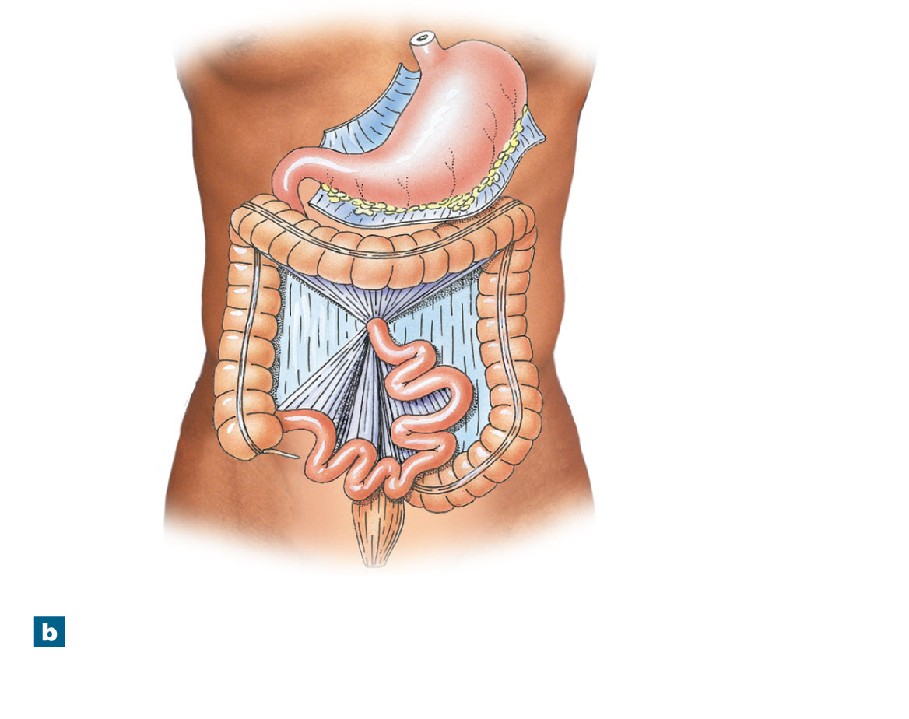
Figure 24-2b Mesenteries
Greater
omentum (cut)
Lesser
omentum
Transverse
mesocolon
Transverse
colon
Mesocolon of ascending
and descending colons
fused to posterior portion
of the parietal peritoneum
Ascending
colon
Mesentery
proper
(mesenterial
sheet)
Descending
colon
Small
intestine
Sigmoid
colon
A diagrammatic view of the organization of
mesenteries in an adult.
Notes:
19

Slide 20
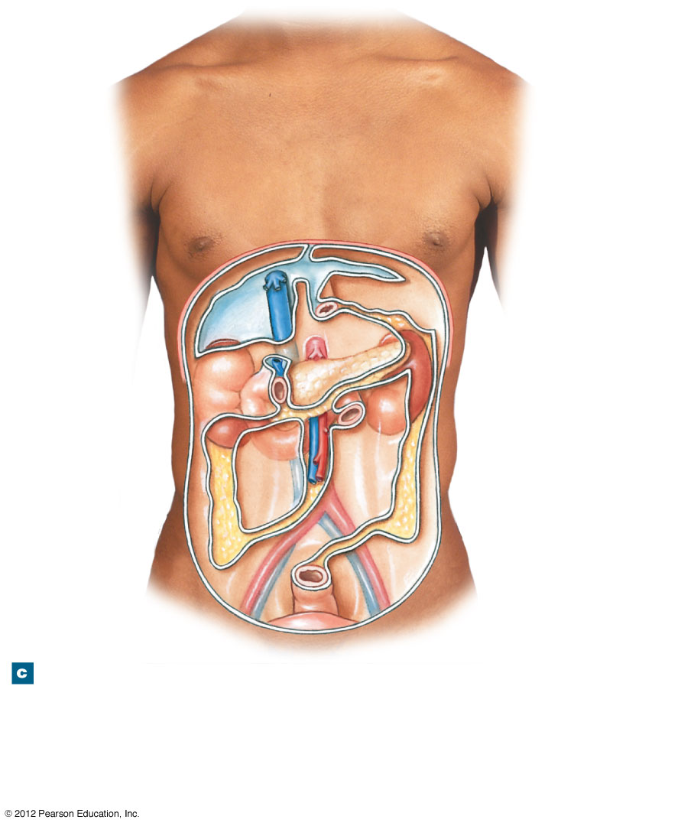
Figure 28-2c Mesenteries
Falciform
ligament
Diaphragm
Inferior
vena cava
Esophagus
Coronary
ligament
of liver
Pancreas
Left kidney
Right kidney
Attachment of
transverse mesocolon
Duodenum
Position of
ascending
colon
Superior mesenteric
artery and vein
Position of
descending colon
Root of
mesentery
proper
Attachment of
sigmoid mesocolon
Rectum
Parietal
peritoneum
Urinary
bladder
An anterior view of the empty peritoneal cavity,
showing the attachment of mesenteries to the
posterior body wall.
Notes:
20

Slide 21
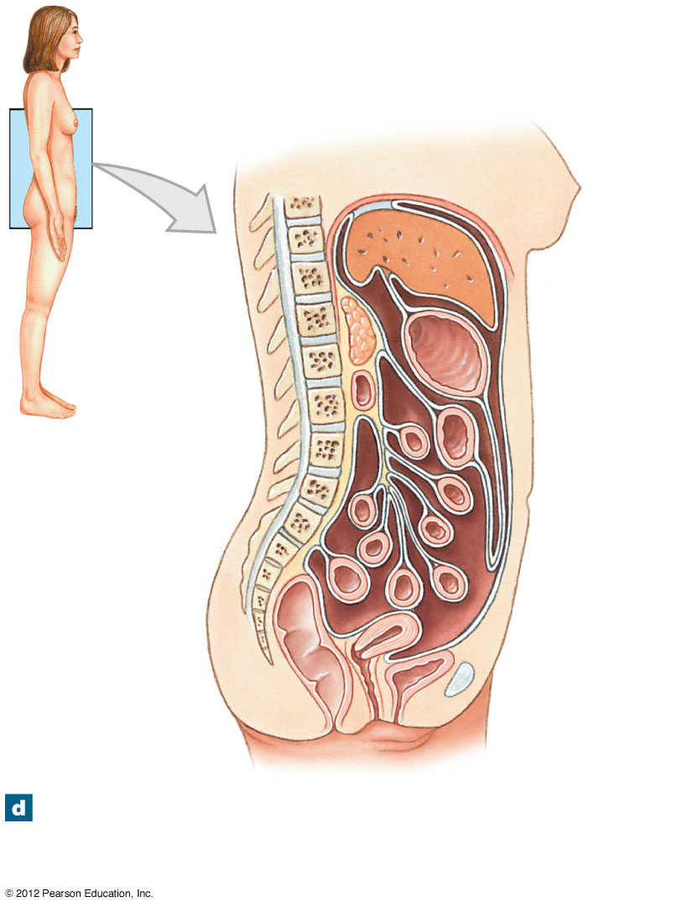
Figure 24-2d Mesenteries
Falciform
ligament
Diaphragm
Liver
Lesser
omentum
Stomach
Pancreas
Transverse
mesocolon
Duodenum
Transverse
colon
Mesentery
proper
Greater
omentum
Sigmoid
mesocolon
Parietal
peritoneum
Rectum
Small
intestine
Urinary
bladder
Uterus
A sagittal section showing the mesenteries of
an adult. Notice that the pancreas, duodenum,
and rectum are retroperitoneal.
Notes:
21

Slide 22
24-1 The Digestive Tract
Histological Organization of the Digestive Tract
  Four major layers of the digestive tract
    Mucosa
    Submucosa
    Muscularis externa
    Serosa

Slide 23
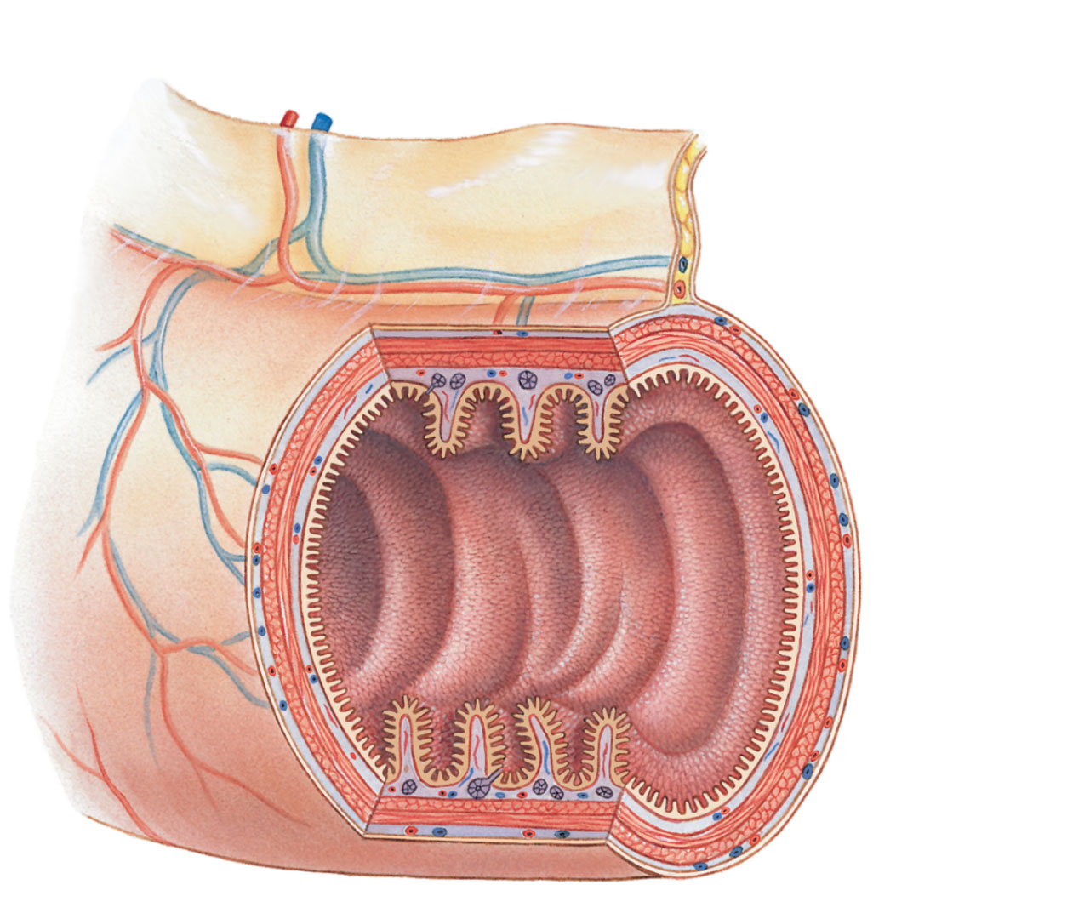
Figure 24-3 The Structure of the Digestive Tract
Mesenteric
artery and vein
Plica
circulares
Mesentery
Mucosa
Submucosa
Muscularis
externa
Serosa
(visceral
peritoneum)
Notes:
23

Slide 24
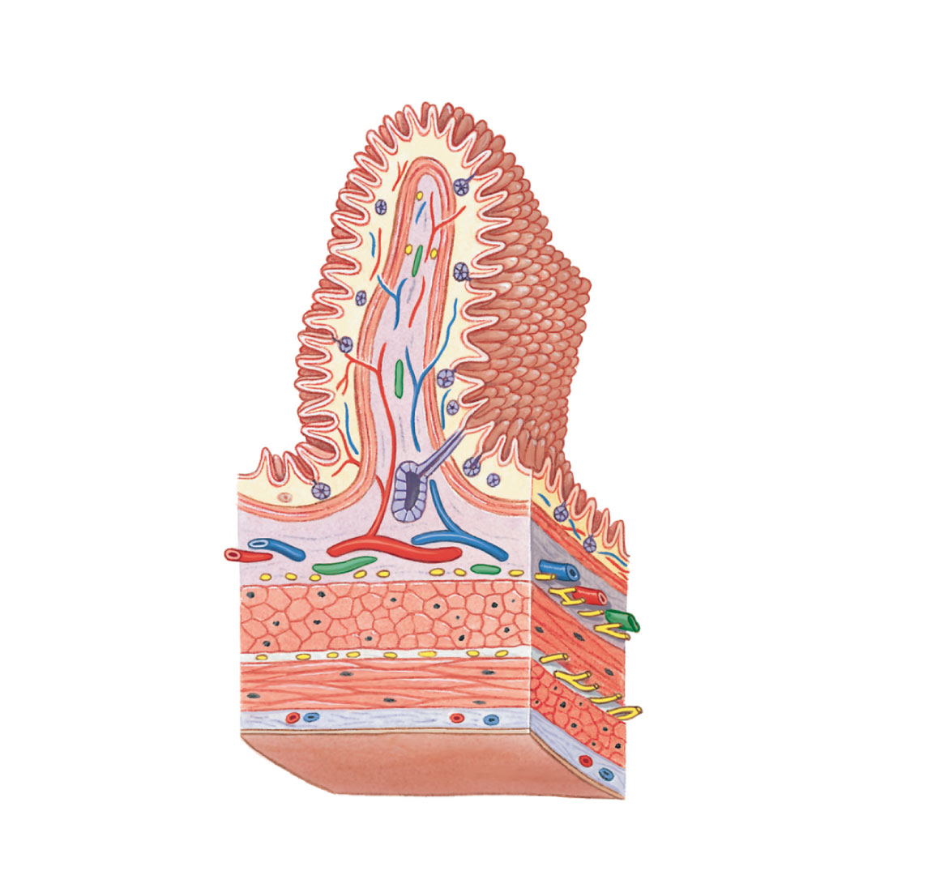
Figure 24-3 The Structure of the Digestive Tract
Plica
circulares
Mucosal
epithelium
Mucosa
Lamina
propria
Villi
Mucosal glands
Submucosal gland
Muscularis
mucosae
Lymphatic vessel
Mucosa
Artery and vein
Submucosa
Submucosal
plexus
Muscularis
externa
Circular muscle
layer
Serosa
(visceral
peritoneum)
Myenteric plexus
Longitudinal
muscle layer
Notes:
24

Slide 25
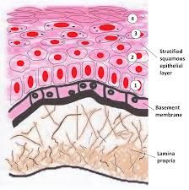
24-1 The Digestive Tract
The Mucosa
  Is the inner lining of digestive tract
  Is a mucous membrane consisting of:
    1. Epithelium, moistened by glandular secretions
    2. Lamina propria of areolar tissue

Slide 26
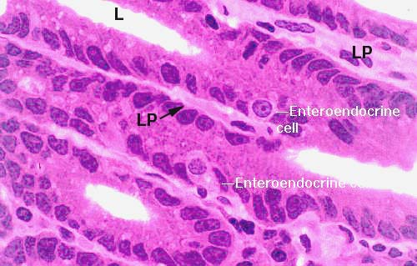
24-1 The Digestive Tract
The Digestive Epithelium
  Mucosal epithelium is simple or stratified
    Depending on location, function, and stresses
  Enteroendocrine cells
    Are scattered among columnar cells of digestive epithelium
    Secrete hormones that:
      Coordinate activities of the digestive tract and accessory glands

Slide 27
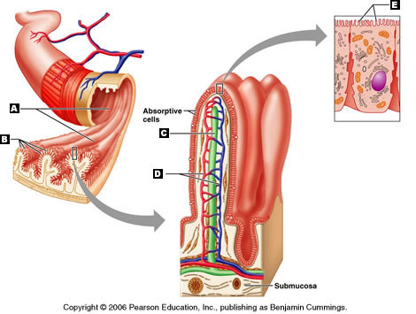
24-1 The Digestive Tract
Lining of Digestive Tract
  Folding increases surface area for absorption
    Longitudinal folds, disappear as digestive tract fills
    Permanent transverse folds (plicae circulares)

Slide 28
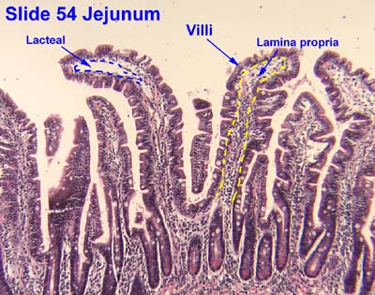
24-1 The Digestive Tract
The Lamina Propria
  Consists of a layer of areolar tissue that contains:
    Blood vessels
    Sensory nerve endings
    Lymphatic vessels
    Smooth muscle cells
    Scattered areas of lymphoid tissue

Slide 29
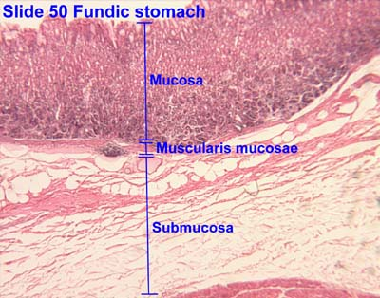
24-1 The Digestive Tract
The Lamina Propria
  Muscularis mucosae
    Narrow band of smooth muscle and elastic fibers in lamina propria
    Smooth muscle cells arranged in two concentric layers
      Inner layer encircles lumen (circular muscle)
      Outer layer contains muscle cells parallel to tract (longitudinal layer)

Slide 30

24-1 The Digestive Tract
The Submucosa
  Is a layer of dense, irregular connective tissue
  Surrounds muscularis mucosae
  Has large blood vessels and lymphatic vessels
  May contain exocrine glands
    Secrete buffers and enzymes into digestive tract
  Submucosal Plexus
    Also called plexus of Meissner
    Innervates the mucosa and submucosa

Slide 31
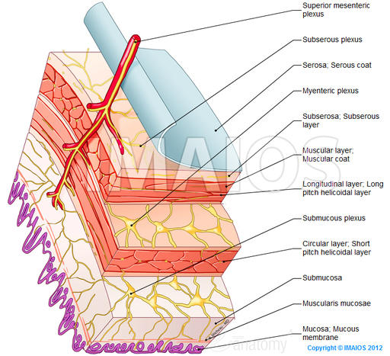

Slide 32
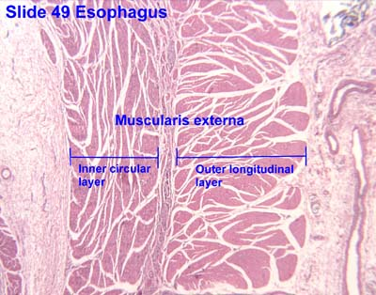
24-1 The Digestive Tract
The Muscularis Externa
  Is dominated by smooth muscle cells
  Are arranged in:
    Inner circular layer
    Outer longitudinal layer
  Involved in:
    Mechanical processing
    Movement of materials along digestive tract
  Innervated primarily by the myenteric plexus (plexus of Auerbach)

Slide 33
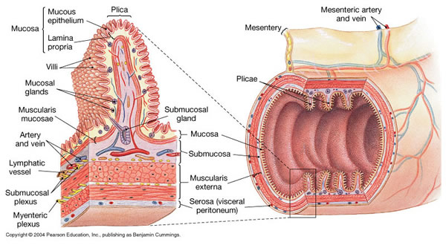
24-1 The Digestive Tract
The Serosa
  Serous membrane covering muscularis externa
    Except in oral cavity, pharynx, esophagus, and rectum
      Where adventitia, a dense sheath of collagen fibers, firmly attaches the digestive tract to adjacent structures

Slide 34
24-1 The Digestive Tract
The Movement of Digestive Materials
  By muscular layers of digestive tract
    Consist of visceral smooth muscle tissue
    Along digestive tract
      Has rhythmic cycles of activity
      Controlled by pacesetter cells
    Cells undergo spontaneous depolarization
      Triggering wave of contraction through entire muscular sheet

Slide 35
24-1 The Digestive Tract
Pacesetter Cells
  Located in muscularis mucosae and muscularis externa
    Surrounding lumen of digestive tract
Peristalsis
  Consists of waves of muscular contractions
  Moves a bolus along the length of the digestive tract

Slide 36
24-1 The Digestive Tract
Peristaltic Motion
  Circular muscles contract behind bolus
    While circular muscles ahead of bolus relax
  Longitudinal muscles ahead of bolus contract
    Shortening adjacent segments
  Wave of contraction in circular muscles
    Forces bolus forward

Slide 37
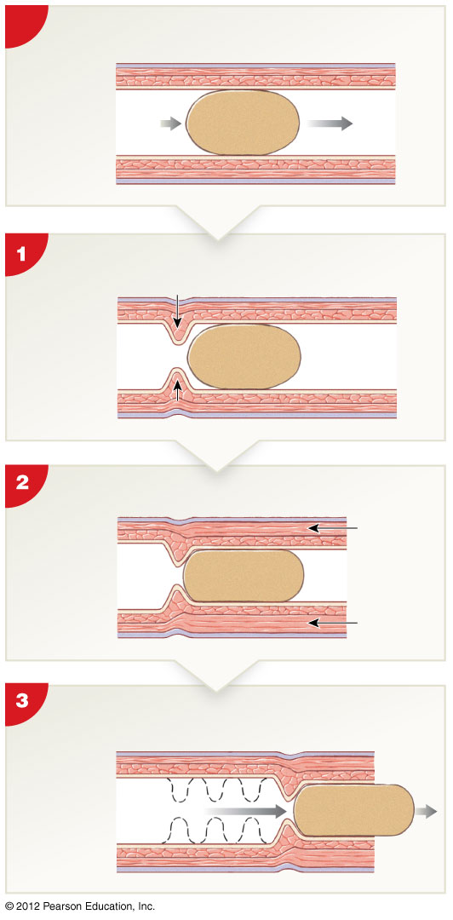
Figure 24-4 Peristalsis
Initial State
Longitudinal
muscle
Circular
muscle
From
mouth
To
anus
Contraction of circular muscles behind
bolus
Contraction
Contraction of longitudinal muscles
ahead of bolus
Contraction
Contraction
Contraction in circular muscle layer
forces bolus forward
Notes:
37

Slide 38
24-1 The Digestive Tract
Segmentation
  Cycles of contraction
    Churn and fragment the bolus
    Mix contents with intestinal secretions
  Does not follow a set pattern
    Does not push materials in any one direction

Slide 39
24-1 The Digestive Tract
Control of Digestive Functions
  Local Factors
    Prostaglandins, histamine, and other chemicals released into interstitial fluid
      May affect adjacent cells within small segment of digestive tract
    Coordinate response to changing conditions
      For example, variations in local pH, chemical, or physical stimuli
    Affect only a portion of tract

Slide 40
24-1 The Digestive Tract
Control of Digestive Functions
  Neural Mechanisms
    Control
      Movement of materials along digestive tract
      Secretory functions
    Motor neurons
      Control smooth muscle contraction and glandular secretion
      Located in myenteric plexus

Slide 41
24-1 The Digestive Tract
Hormonal Mechanisms
  At least 18 peptide hormones that affect:
    Most aspects of digestive function
    Activities of other systems
  Are produced by enteroendocrine cells in digestive tract
  Reach target organs after distribution in bloodstream

Slide 42
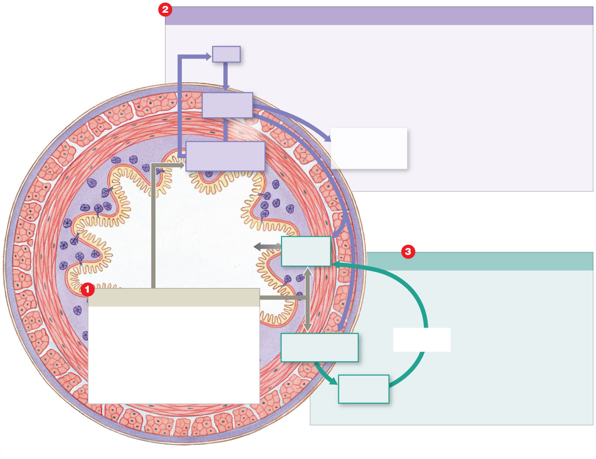
Figure 24-5 The Regulation of Digestive Activities
Neural Control Mechanisms
CNS
Long
reflex
Myenteric
plexus
Short
reflex
Peristalsis and
segmentation
movements
Stretch receptors,
chemoreceptors
Buffers, acids,
enzymes released
Secretory
cells
Hormonal Control Mechanisms
Local Factors
Enteroendocrine
cells
Via the
bloodstream
Hormones
released
Notes:
42

