Slide 1
12-7 Synapses
Synaptic Activity
  Action potentials (nerve impulses)
    Are transmitted from presynaptic neuron
    To postsynaptic neuron (or other postsynaptic cell)
    Across a synapse

Slide 2
12-7 Synapses
Two Types of Synapses
  Electrical synapses
    Direct physical contact between cells
  Chemical synapses
    Signal transmitted across a gap by chemical neurotransmitters

Slide 3
12-7 Synapses
Chemical Synapses
  Are found in most synapses between neurons and all synapses between neurons and other cells
  Cells not in direct contact
  Action potential may or may not be propagated to postsynaptic cell, depending on:
    Amount of neurotransmitter released
    Sensitivity of postsynaptic cell

Slide 4
12-7 Synapses
Two Classes of Neurotransmitters
  Excitatory neurotransmitters
    Cause depolarization of postsynaptic membranes
    Promote action potentials
  Inhibitory neurotransmitters
    Cause hyperpolarization of postsynaptic membranes
    Suppress action potentials

Slide 5
12-7 Synapses
The Effect of a Neurotransmitter
  On a postsynaptic membrane
    Depends on the receptor
    Not on the neurotransmitter
  For example, acetylcholine (ACh)
    Usually promotes action potentials
    But inhibits cardiac neuromuscular junctions

Slide 6
12-7 Synapses
Cholinergic Synapses
  Any synapse that releases ACh at:
    All neuromuscular junctions with skeletal muscle fibers
    Many synapses in CNS
    All neuron-to-neuron synapses in PNS
    All neuromuscular and neuroglandular junctions of ANS parasympathetic division

Slide 7
12-7 Synapses
Events at a Cholinergic Synapse
  Action potential arrives, depolarizes synaptic terminal
  Calcium ions enter synaptic terminal, trigger exocytosis of ACh
  ACh binds to receptors, depolarizes postsynaptic membrane
  ACh removed by AChE
    AChE breaks ACh into acetate and choline

Slide 8
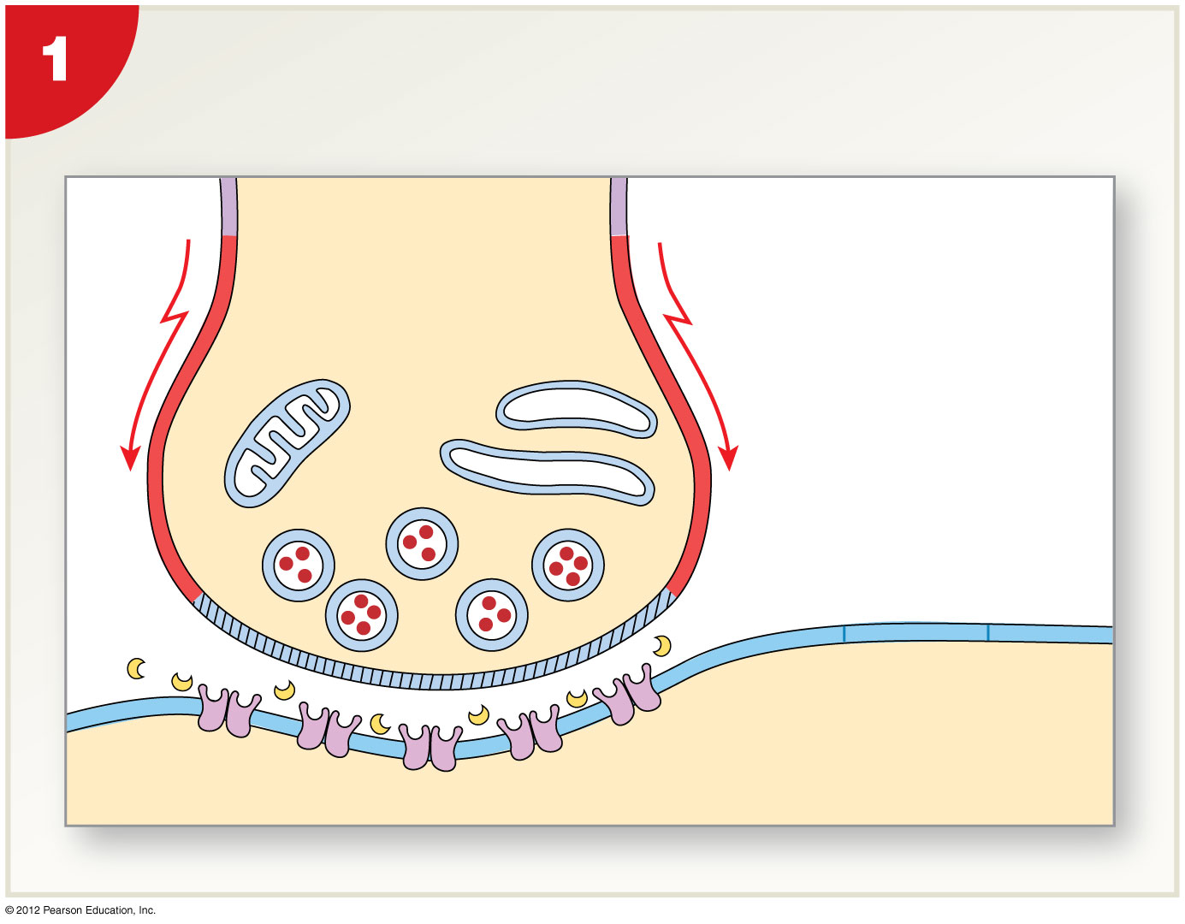
Figure 12-17 Events in the Functioning of a Cholinergic Synapse
An action potential arrives and
depolarizes the synaptic terminal
Presynaptic neuron
Action potential
Synaptic vesicles
EXTRACELLULAR
FLUID
ER
Synaptic
terminal
Initial
segment
AChE
POSTSYNAPTIC
NEURON
Notes:
8

Slide 9
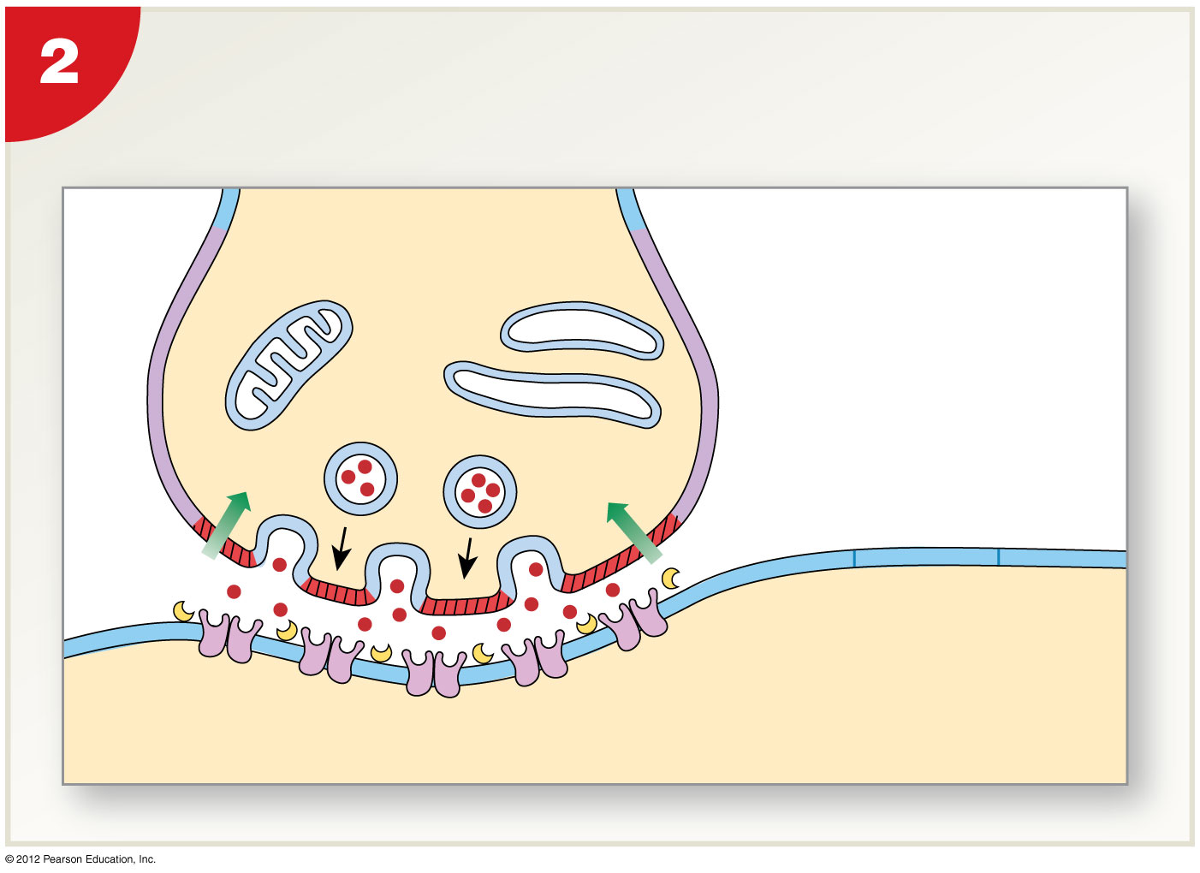
Figure 12-17 Events in the Functioning of a Cholinergic Synapse
Extracellular Ca²⁺ enters the synaptic
terminal, triggering the exocytosis of ACh
ACh
Ca²⁺
Ca²⁺
Synaptic cleft
Chemically gated
sodium ion channels
Notes:
9

Slide 10
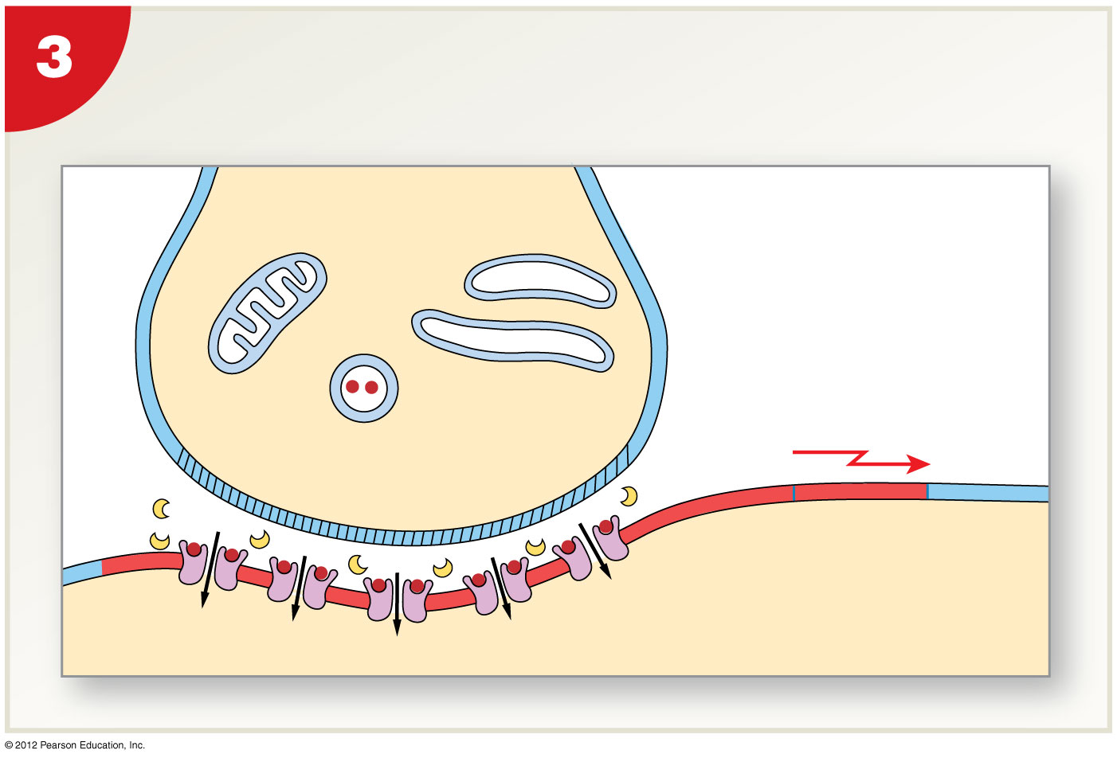
Figure 12-17 Events in the Functioning of a Cholinergic Synapse
ACh binds to receptors and depolarizes
the postsynaptic membrane
Initiation of
action potential
if threshold is
reached at the
initial segment
Na⁺
Na⁺
Na⁺
Na⁺
Na⁺
Notes:
10

Slide 11
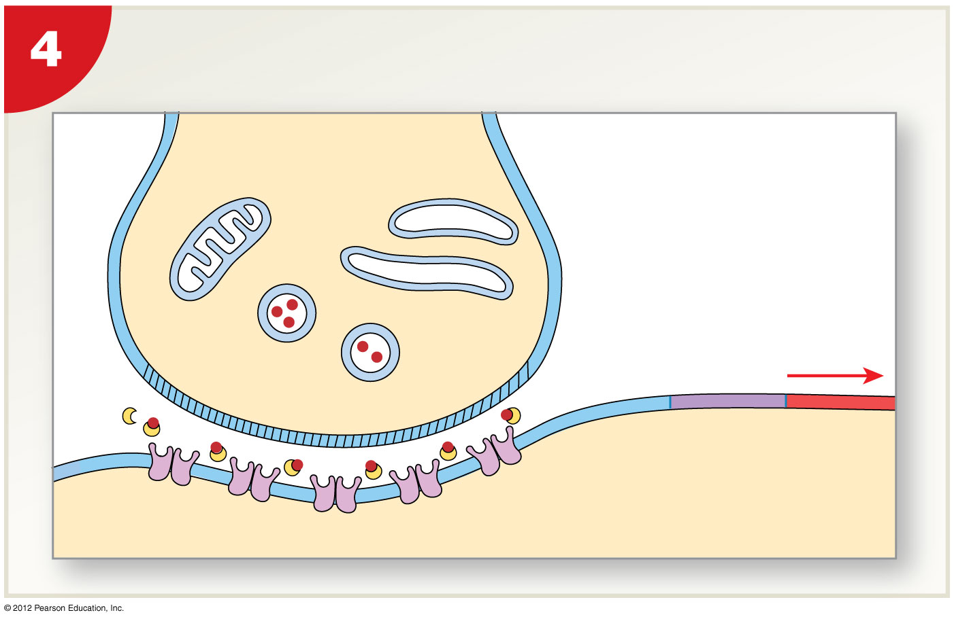
Figure 12-17 Events in the Functioning of a Cholinergic Synapse
ACh is removed by AChE
Propagation of
action potential
(if generated)
Notes:
11

Slide 12
12-7 Synapses
Synaptic Delay
  A synaptic delay of 0.2–0.5 msec occurs between:
    Arrival of action potential at synaptic terminal
    And effect on postsynaptic membrane
  Fewer synapses mean faster response
  Reflexes may involve only one synapse

Slide 13
12-7 Synapses
Synaptic Fatigue
  Occurs when neurotransmitter cannot recycle fast enough to meet demands of intense stimuli
  Synapse inactive until ACh is replenished

Slide 14
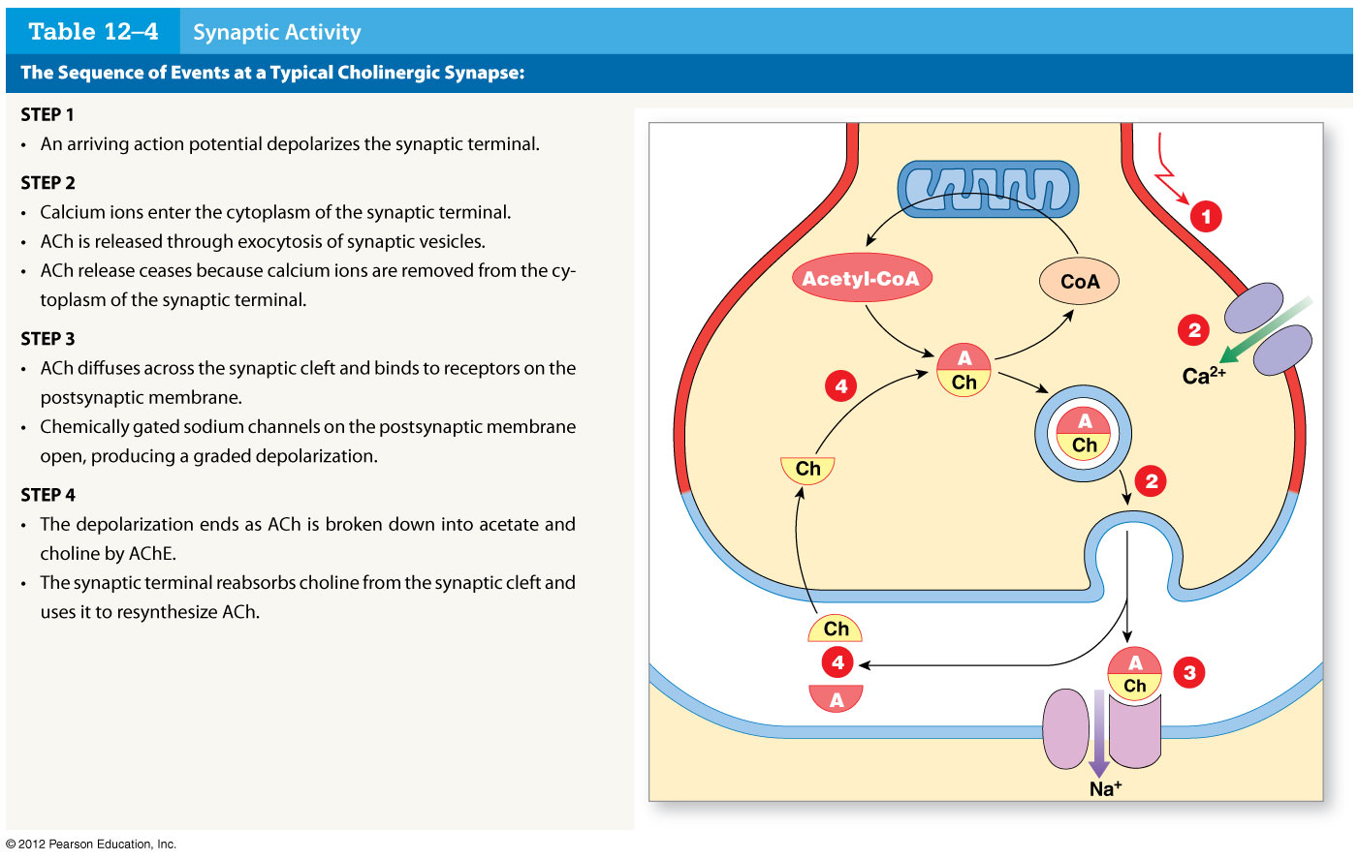
Table 12-4 Synaptic Activity
Mitochondrion
Acetylcholine
Synaptic
vesicle
SYNAPTIC
TERMINAL
Choline
SYNAPTIC
CLEFT
Acetylcholinesterase
Acetate
(AChE)
POSTSYNAPTIC
MEMBRANE
ACh
receptor
Notes:
14

Slide 15
12-8 Neurotransmitters and Neuromodulators
Other Neurotransmitters
  At least 50 neurotransmitters other than ACh, including:
    Biogenic amines
    Amino acids
    Neuropeptides
    Dissolved gases

Slide 16
12-8 Neurotransmitters and Neuromodulators
Important Neurotransmitters
  Other than acetylcholine
    Norepinephrine (NE)
    Dopamine
    Serotonin

Slide 17
12-8 Neurotransmitters and Neuromodulators
Norepinephrine (NE)
  Released by adrenergic synapses
  Excitatory and depolarizing effect
  Widely distributed in brain and portions of ANS
Dopamine
  A CNS neurotransmitter
  May be excitatory or inhibitory
  Involved in Parkinson’s disease and cocaine use
Serotonin
  A CNS neurotransmitter
  Affects attention and emotional states

Slide 18
12-8 Neurotransmitters and Neuromodulators
Chemical Synapse
  The synaptic terminal releases a neurotransmitter that binds to the postsynaptic plasma membrane
  Produces temporary, localized change in permeability or function of postsynaptic cell
  Changes affect cell, depending on nature and number of stimulated receptors

Slide 19
12-8 Neurotransmitters and Neuromodulators
Many Drugs
  Affect nervous system by stimulating receptors that respond to neurotransmitters
  Can have complex effects on perception, motor control, and emotional states

Slide 20
12-8 Neurotransmitters and Neuromodulators
Neuromodulators
  Other chemicals released by synaptic terminals
  Similar in function to neurotransmitters
  Characteristics of neuromodulators
    Effects are long term, slow to appear
    Responses involve multiple steps, intermediary compounds
    Affect presynaptic membrane, postsynaptic membrane, or both
    Released alone or with a neurotransmitter

Slide 21
12-8 Neurotransmitters and Neuromodulators
Neuropeptides
  Neuromodulators that bind to receptors and activate enzymes
Opioids
  Neuromodulators in the CNS
  Bind to the same receptors as opium or morphine
  Relieve pain

Slide 22
12-8 Neurotransmitters and Neuromodulators
Four Classes of Opioids
  Endorphins
  Enkephalins
  Endomorphins
  Dynorphins

Slide 23
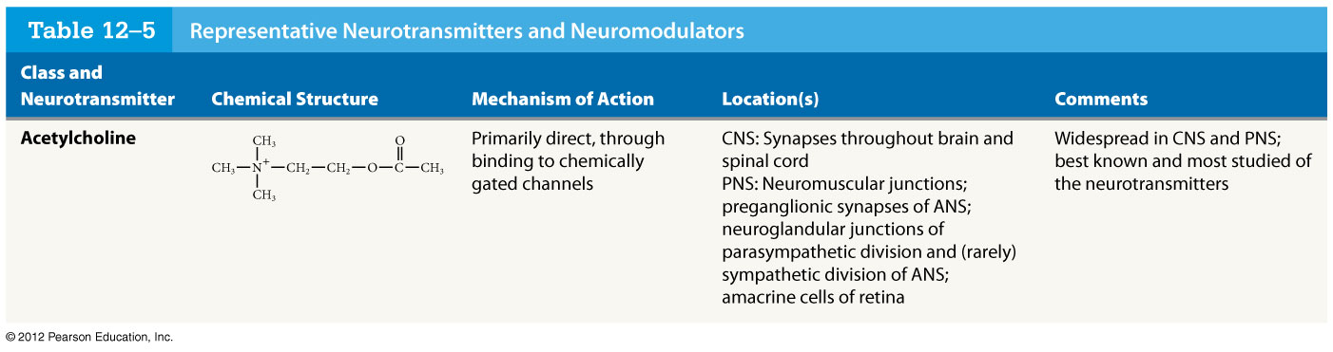
Table 12-5 Representative Neurotransmitters and Neuromodulators
Notes:
23

Slide 24
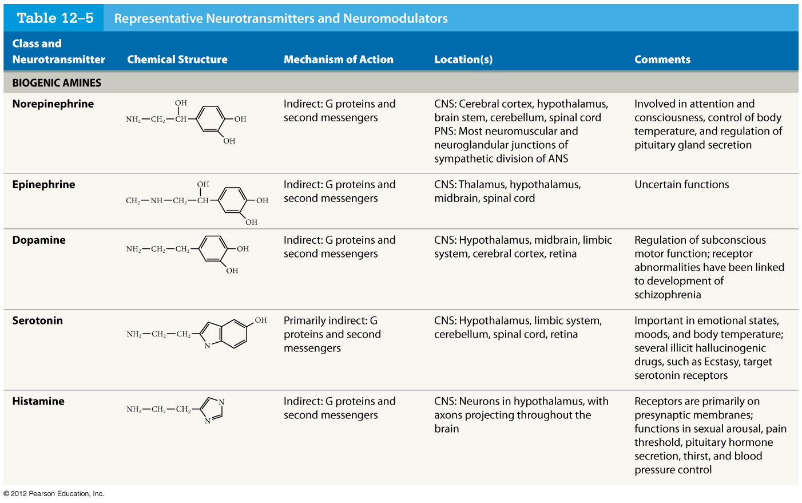
Table 12-5 Representative Neurotransmitters and Neuromodulators
Notes:
24

Slide 25
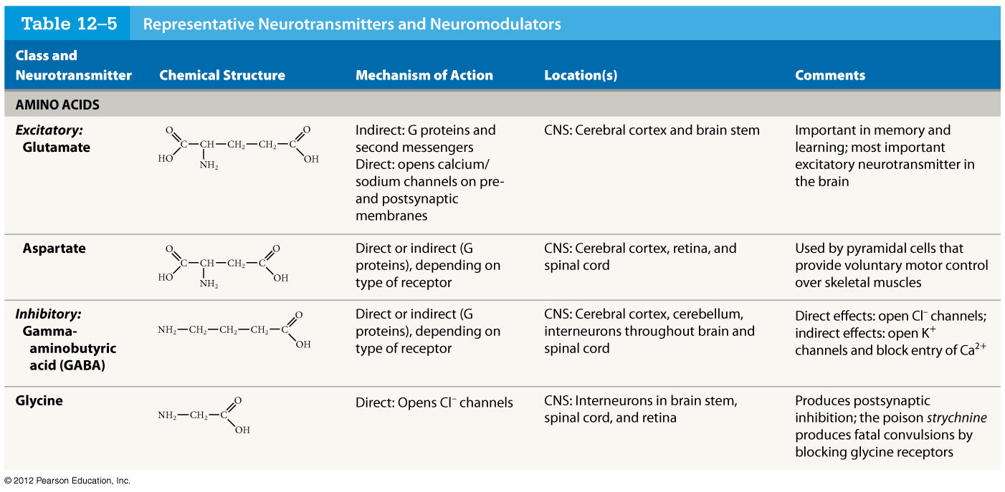
Table 12-5 Representative Neurotransmitters and Neuromodulators
Notes:
25

Slide 26
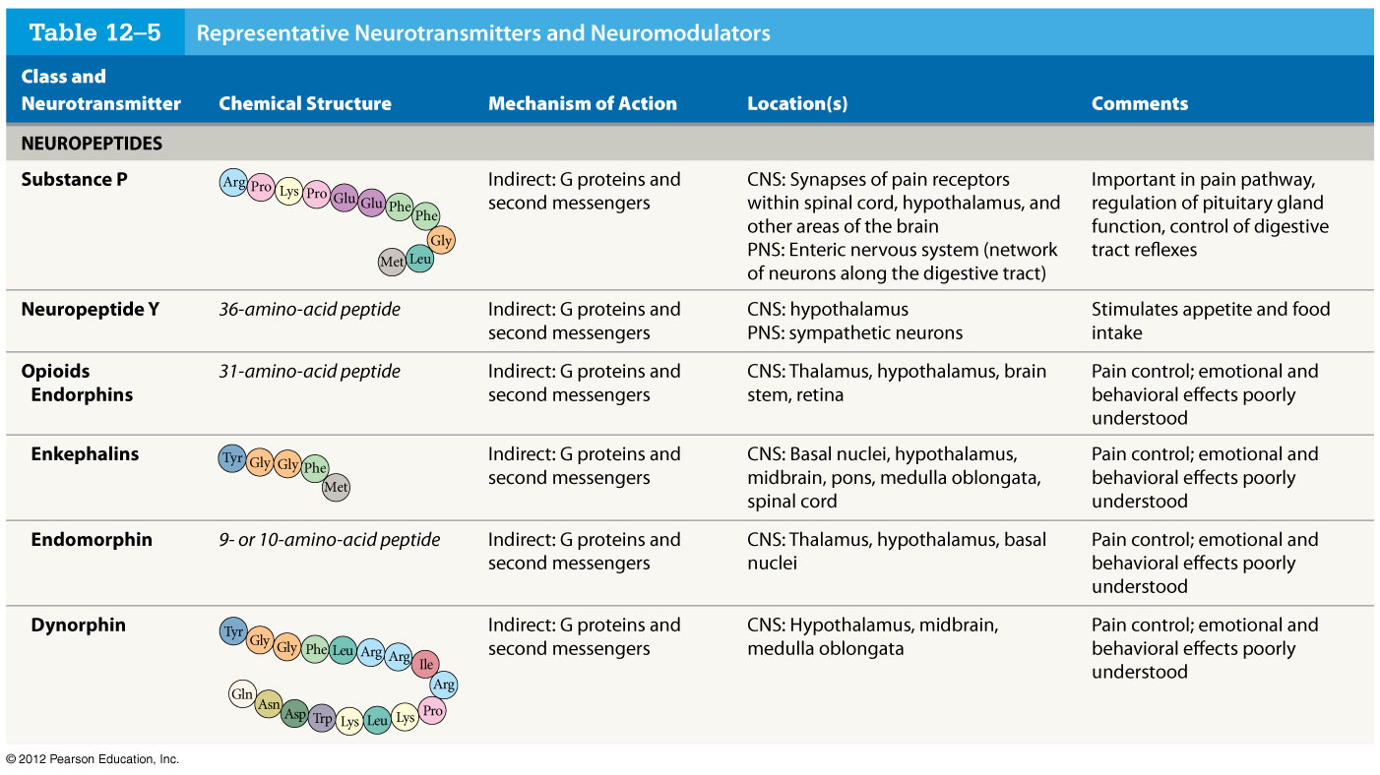
Table 12-5 Representative Neurotransmitters and Neuromodulators
Notes:
26

Slide 27
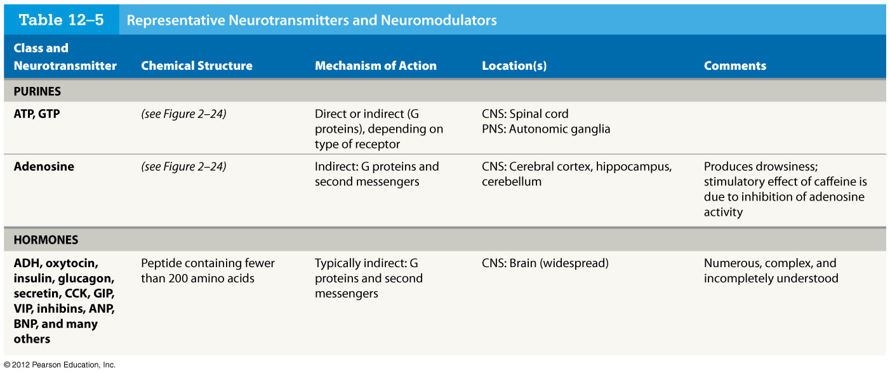
Table 12-5 Representative Neurotransmitters and Neuromodulators
Notes:
27

Slide 28
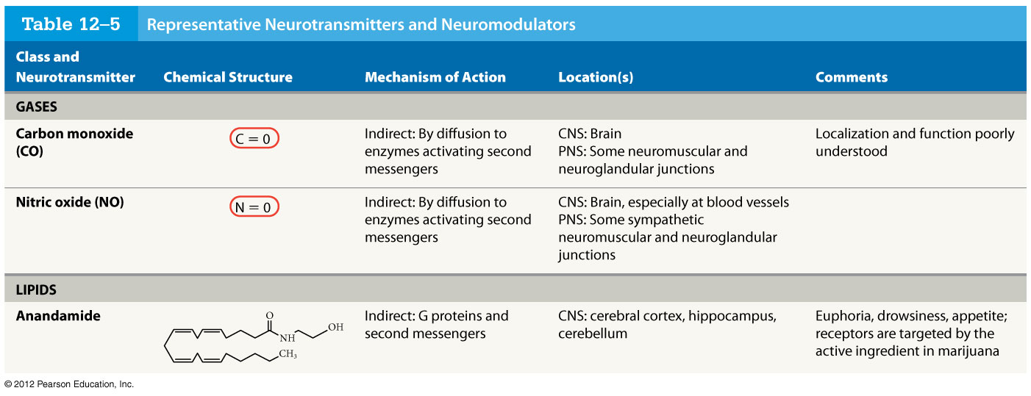
Table 12-5 Representative Neurotransmitters and Neuromodulators
Notes:
28

