Slide 1
12-5 Action Potential
Action Potentials
Propagated changes in transmembrane potential
Affect an entire excitable membrane
Link cell body with motor end plate actions

Slide 2
12-5 Action Potential
Initiating Action Potential
Initial stimulus
A depolarization of axon hillock large enough to change resting potential to threshold level of voltage-gated sodium channels

Slide 3
12-5 Action Potential
Initiating Action Potential
All-or-none principle
If a stimulus exceeds threshold amount
The action potential is the same
No matter how large the stimulus
Action potential is either triggered, or not

Slide 4
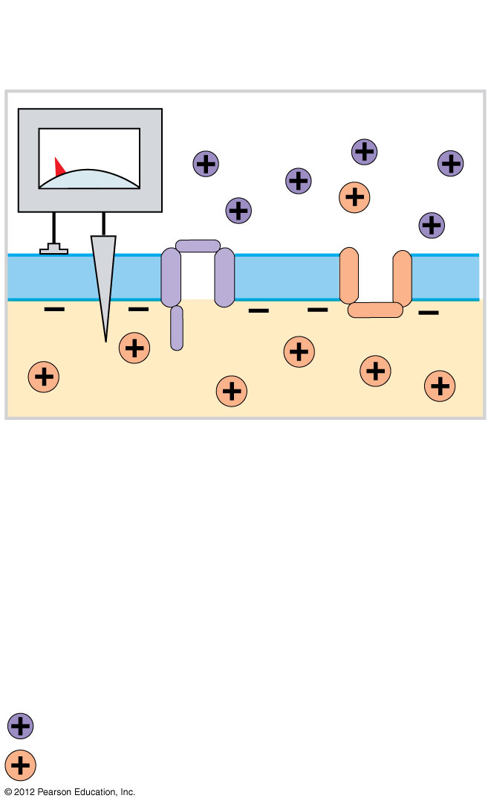
Figure 12-14 Generation of an Action Potential
Resting
Potential
–70 mV
The axolemma contains both voltage-
gated sodium channels and voltage-
gated potassium channels that are
closed when the membrane is at the
resting potential.
KEY
= Sodium ion
= Potassium ion
Notes:
4

Slide 5
12-5 Action Potential
Four Steps in the Generation of Action Potentials
Step 1: Depolarization to threshold
Step 2: Activation of Na⁺ channels
Step 3: Inactivation of Na⁺ channels and activation of K⁺ channels
Step 4: Return to normal permeability

Slide 6
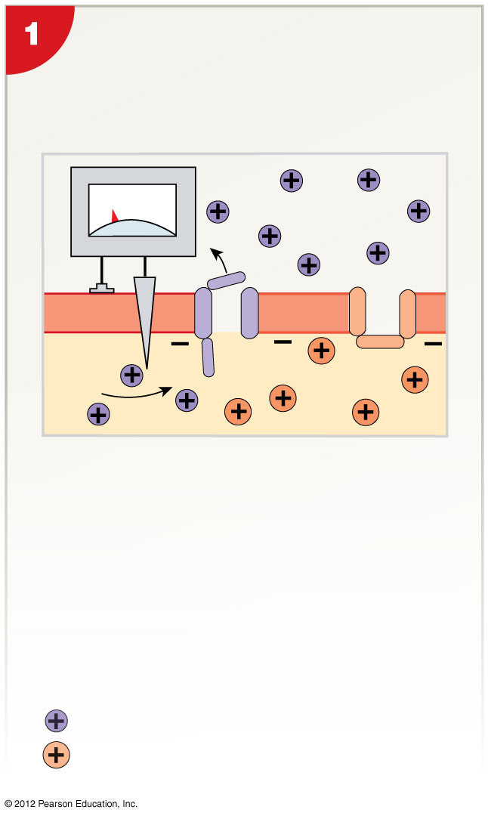
Figure 12-14 Generation of an Action Potential
Depolarization to Threshold
Step 1: Depolarization to threshold
Stimulus initiates action potential large enough to open sodium channels (threshold).
–60 mV
Local
current
KEY
= Sodium ion
= Potassium ion
Notes:
6

Slide 7
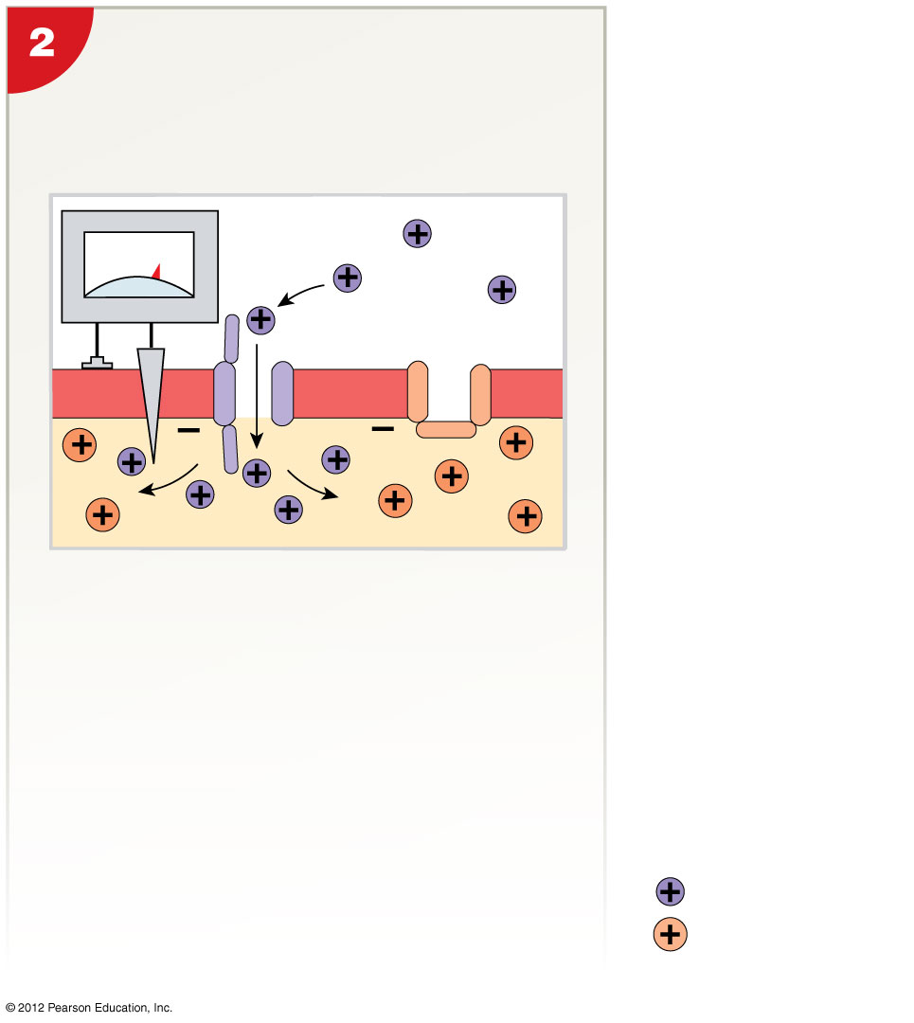
Figure 12-14 Generation of an Action Potential
Activation of Sodium
Channels and Rapid
Depolarization
Step 2: Activation of Na⁺ channels
Rapid depolarization
Na⁺ ions rush into cytoplasm
Inner membrane changes from negative to positive
+10 mV
KEY
= Sodium ion
= Potassium ion
Notes:
7

Slide 8
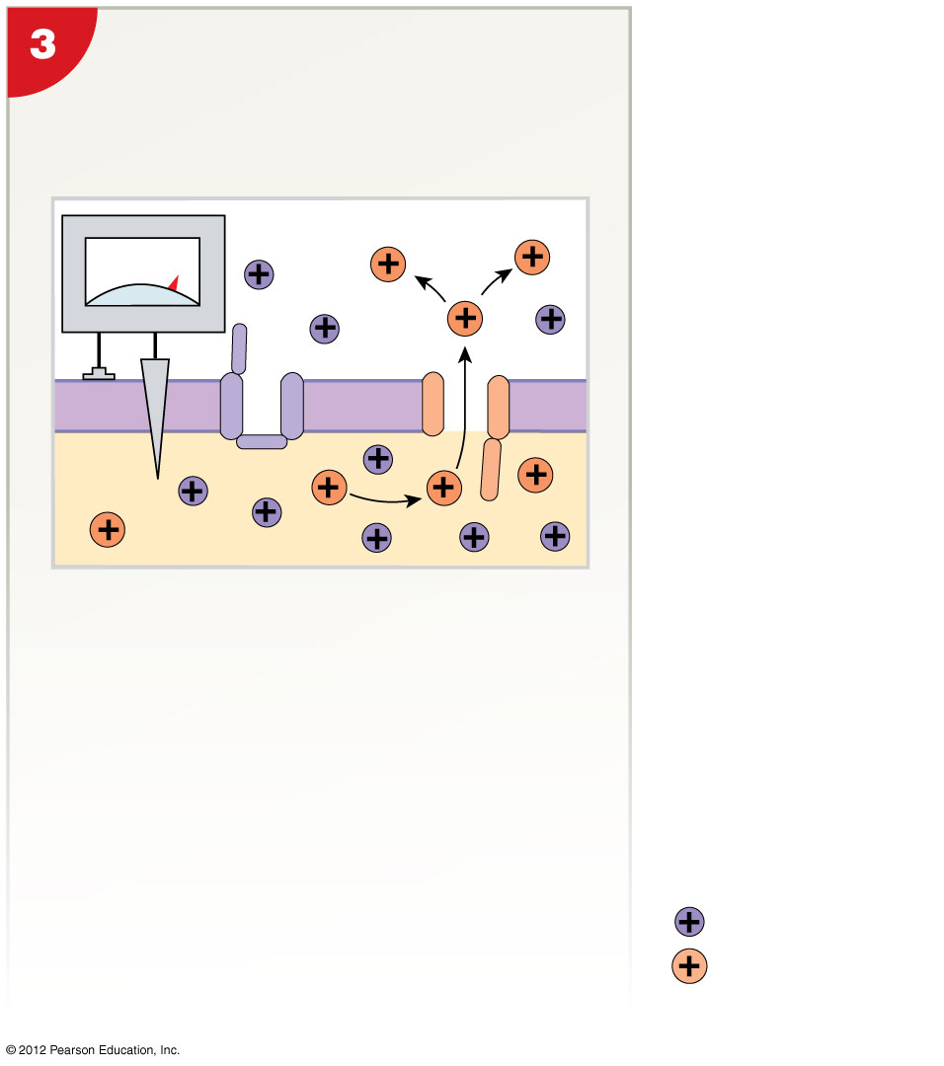
Figure 12-14 Generation of an Action Potential
Inactivation of Sodium
Channels and Activation
of Potassium Channels
Step 3: Inactivation of Na⁺ channels and activation of K⁺ channels
Inactivation gates close (Na⁺ channel inactivation)
K⁺ channels open
Repolarization begins
+30 mV
KEY
= Sodium ion
= Potassium ion
Notes:
8

Slide 9
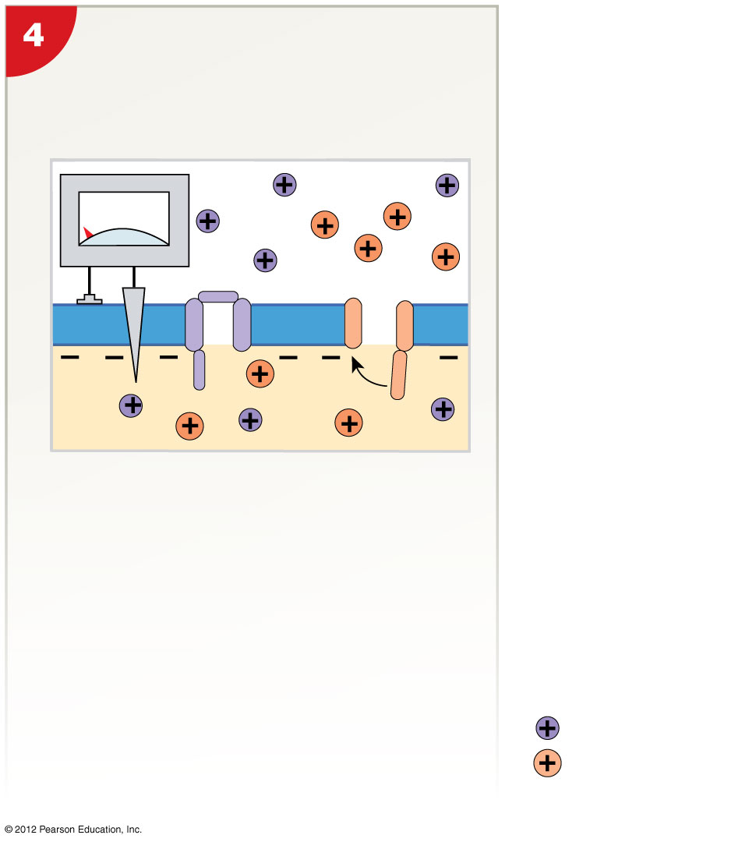
Figure 12-14 Generation of an Action Potential
Step 4: Return to normal permeability
K⁺ channels begin to close
When membrane reaches normal resting potential
K⁺ channels finish closing
Membrane is hyperpolarized to Transmembrane potential returns to resting level
Action potential is over
Closing of Potassium
Channels
–90 mV
KEY
= Sodium ion
= Potassium ion
Notes:
9

Slide 10
12-5 Action Potential
The Refractory Period
The time period
From beginning of action potential
To return to resting state
During which membrane will not respond normally to additional stimuli
A&P FLIX Generation of an Action Potential

Slide 11
12-5 Action Potential
Powering the Sodium–Potassium Exchange Pump
To maintain concentration gradients of Na⁺ and K⁺ over time
Requires energy (1 ATP for each 2 K⁺/3 Na⁺ exchange)
Without ATP
Neurons stop functioning

Slide 12
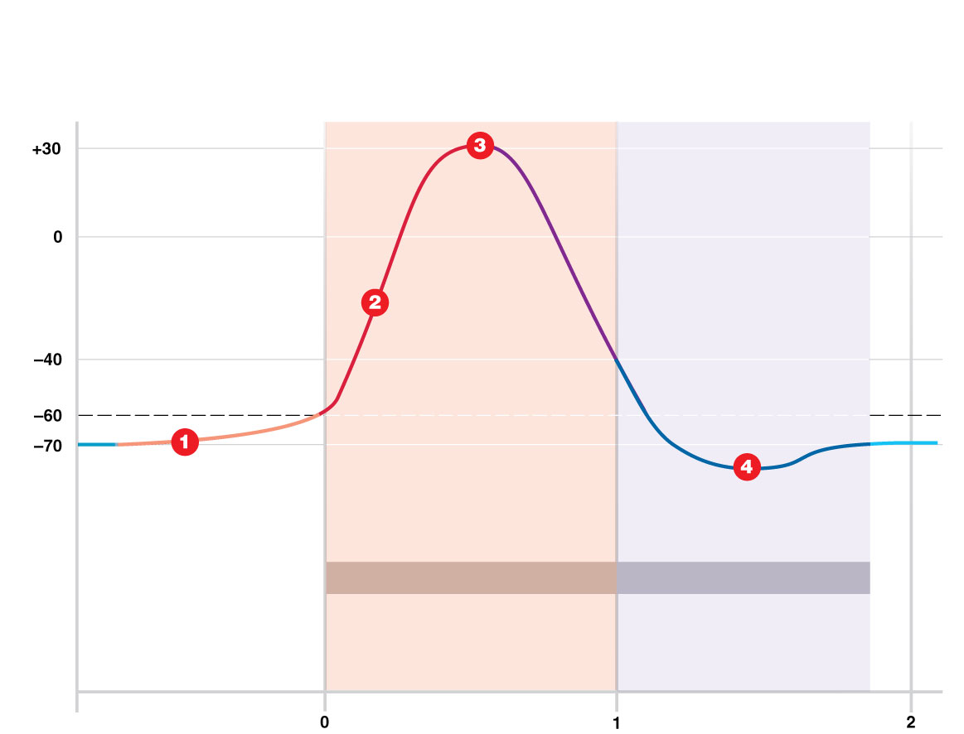
Figure 12-14 Generation of an Action Potential
Sodium channels close, voltage-
gated potassium channels open
D E P O L A R I Z A T I O N
R E P O L A R I Z A T I O N
Resting
potential
Transmembrane potential (mV)
Voltage-gated sodium
ion channels open
Threshold
All channels closed
Graded potential
causes threshold
ABSOLUTE REFRACTORY PERIOD
RELATIVE REFRACTORY PERIOD
Cannot respond
Responds only to a larger
than normal stimulus
Time (msec)
Notes:
12

Slide 13
12-5 Action Potential
Propagation of Action Potentials
Propagation
Moves action potentials generated in axon hillock
Along entire length of axon
Two methods of propagating action potentials
Continuous propagation (unmyelinated axons)
Saltatory propagation (myelinated axons)

Slide 14
12-5 Action Potential
Continuous Propagation
Of action potentials along an unmyelinated axon
Affects one segment of axon at a time
Steps in propagation
Step 1: Action potential in segment 1
Step 2: Depolarizes second segment to threshold
Step 3: First segment enters refractory period
Step 4: Local current depolarizes next segment
Cycle repeats
Action potential travels in one direction (1 m/sec)

Slide 15
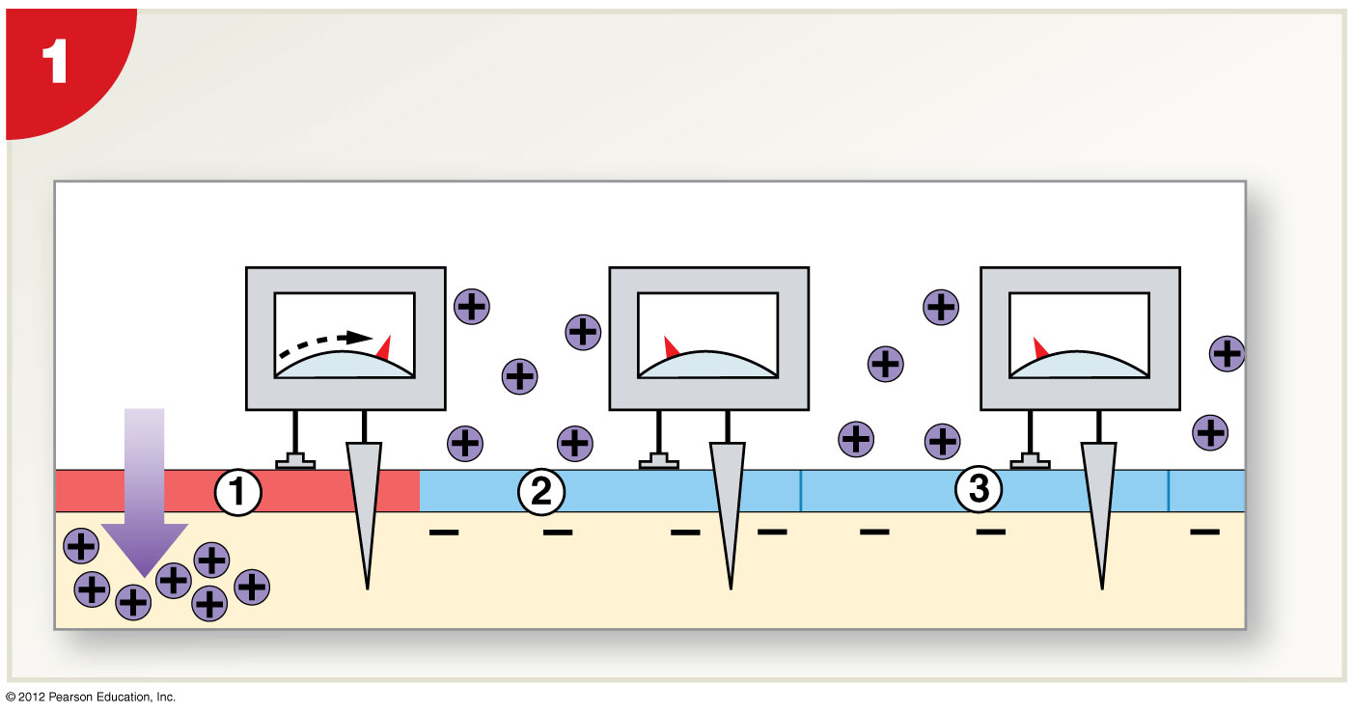
Figure 12-15 Continuous Propagation of an Action Potential along an Unmyelinated Axon
As an action potential develops at the initial segment , the
transmembrane potential at this site depolarizes to +30 mV.
Extracellular Fluid
Action
potential
+30 mV
–70 mV
–70 mV
Na⁺
Cell membrane
Cytosol
Notes:
15

Slide 16
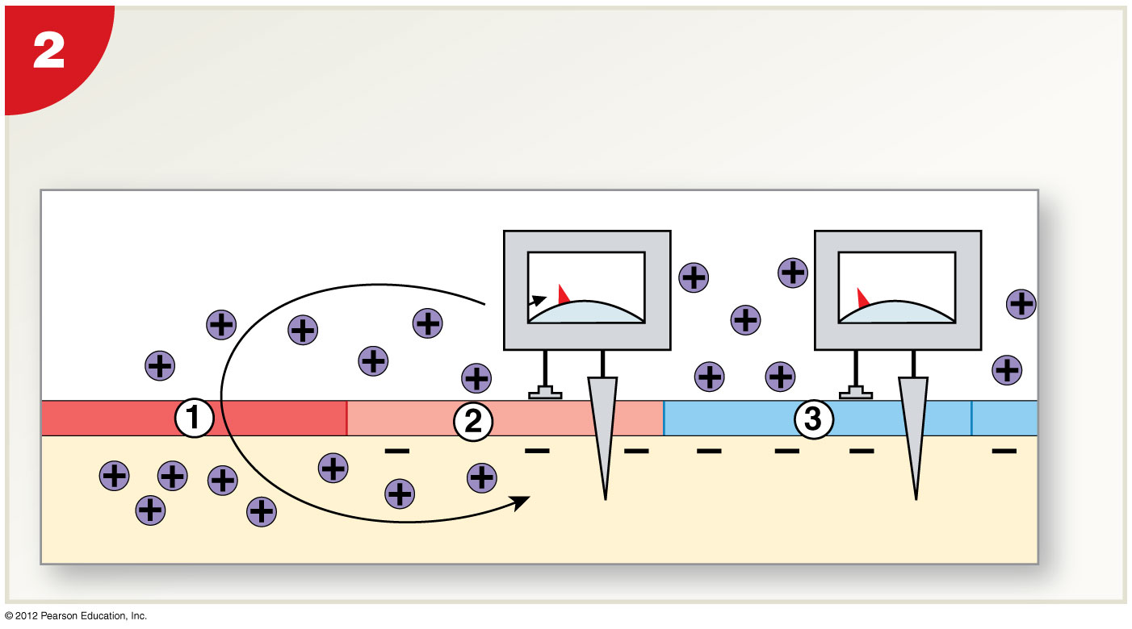
Figure 12-15 Continuous Propagation of an Action Potential along an Unmyelinated Axon
As the sodium ions entering at  spread away from the
open voltage-gated channels, a graded depolarization
quickly brings the membrane in segment  to threshold.
Graded depolarization
–60 mV
–70 mV
Local
current
Notes:
16

Slide 17
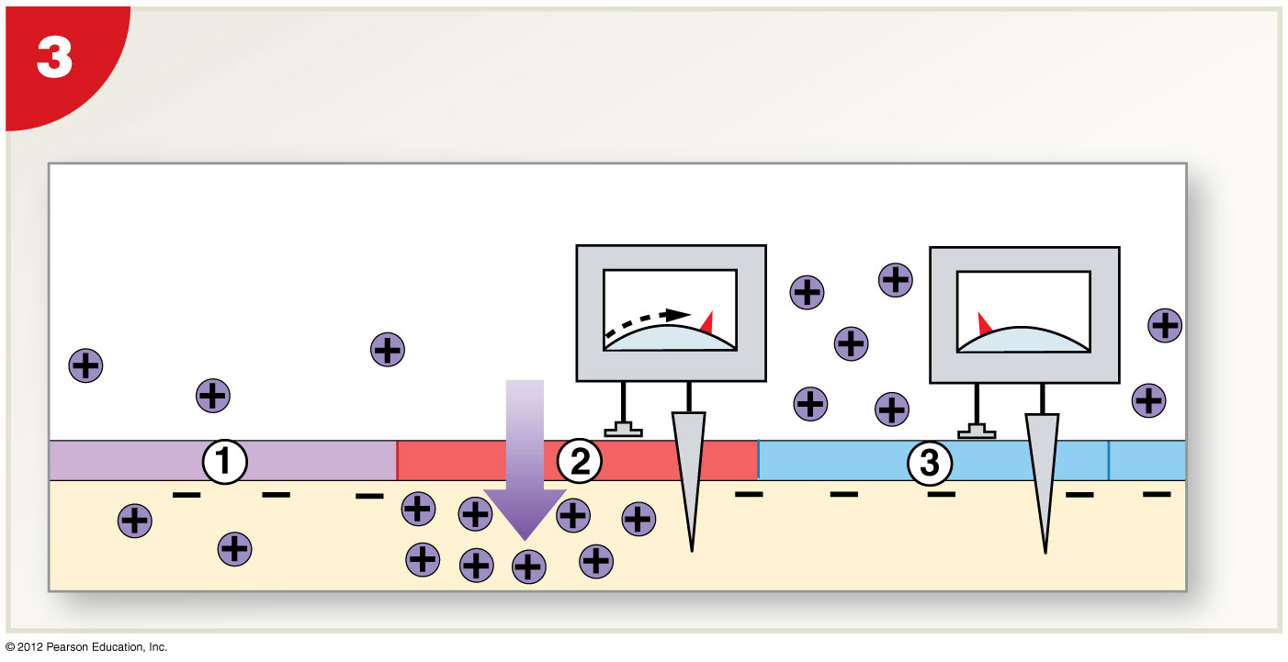
Figure 12-15 Continuous Propagation of an Action Potential along an Unmyelinated Axon
An action potential now occurs in segment  while
segment  beings repolarization.
Repolarization
(refractory)
+30 mV
–70 mV
Na⁺
Notes:
17

Slide 18
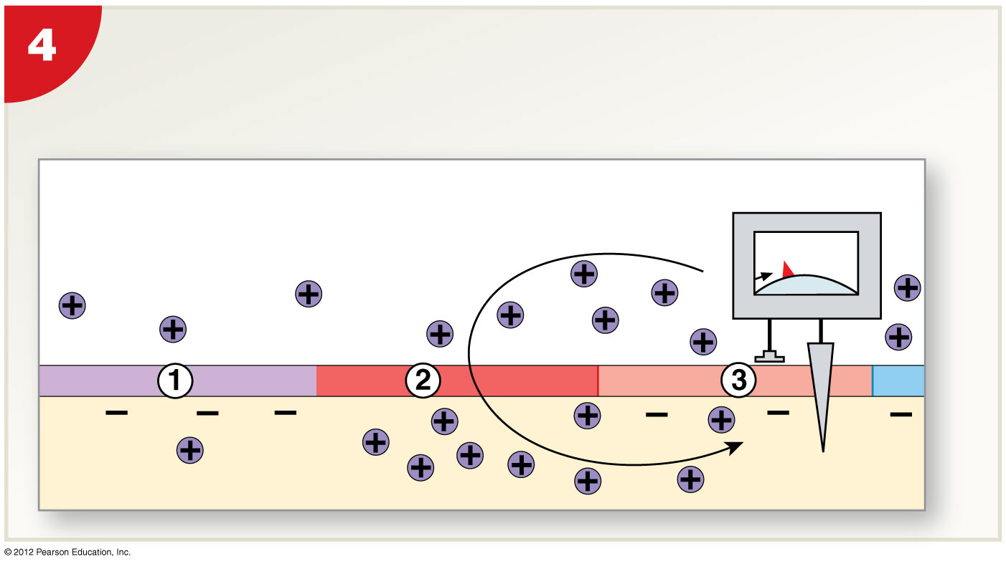
Figure 12-15 Continuous Propagation of an Action Potential along an Unmyelinated Axon
As the sodium ions entering at segment  spread laterally,
a graded depolarization quickly brings the membrane in
segment  to threshold, and the cycle is repeated.
–60 mV
Local
current
Notes:
18

Slide 19
12-5 Action Potential
Saltatory Propagation
Action potential along myelinated axon
Faster and uses less energy than continuous propagation
Myelin insulates axon, prevents continuous propagation
Local current “jumps” from node to node
Depolarization occurs only at nodes

Slide 20
Figure 12-16 Saltatory Propagation along a Myelinated Axon
An action potential
has occurred at the
initial segment .
Extracellular Fluid
+30 mV
–70 mV
–70 mV
Na⁺
Myelinated
internode
Myelinated
internode
Myelinated
internode
Plasma membrane
Cytosol
Notes:
20

Slide 21
Figure 12-16 Saltatory Propagation along a Myelinated Axon
A local current
produces a graded
depolarization that
brings the axolemma
at the next node to
threshold.
–60 mV
–70 mV
Local
current
Notes:
21

Slide 22
Figure 12-16 Saltatory Propagation along a Myelinated Axon
An action potential
develops at node .
Repolarization
(refractory)
+30 mV
–70 mV
Na⁺
Notes:
22

Slide 23
Figure 12-16 Saltatory Propagation along a Myelinated Axon
A local current
produces a graded
depolarization that
brings the axolemma
at node  to
threshold.
–60 mV
Local
current
A&P FLIX Propagation of an Action Potential
Notes:
23

