Slide 1
24-2: Oral Cavity

Slide 2
24-2 The Oral Cavity
Functions of the Oral Cavity
Sensory analysis
Of material before swallowing
Mechanical processing
Through actions of teeth, tongue, and palatal surfaces
Lubrication
Mixing with mucus and salivary gland secretions
Limited digestion
Of carbohydrates and lipids

Slide 3
24-2 The Oral Cavity
Oral Mucosa
Lining of oral cavity
Has stratified squamous epithelium
Of cheeks, lips, and inferior surface of tongue
Is relatively thin and delicate

Slide 4
24-2 The Oral Cavity
Labia
Also called lips
Anteriorly, the mucosa of each cheek is continuous with that of the lips
Vestibule
Space between the cheeks (or lips) and the teeth
Gingivae (Gums)
Ridges of oral mucosa
Surround base of each tooth on alveolar processes of maxillary bones and mandible

Slide 5
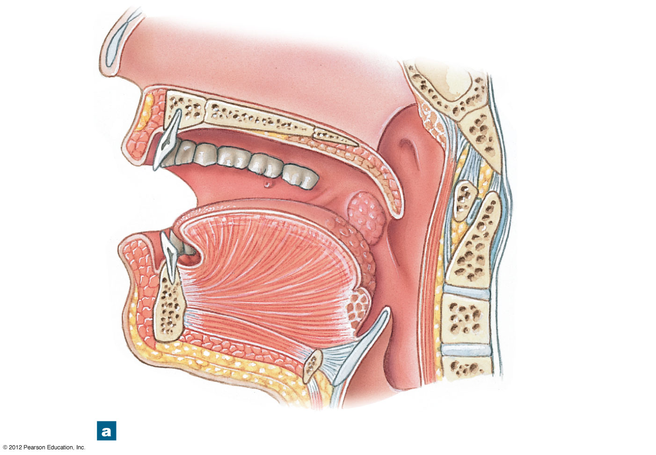
Figure 24-6a The Oral Cavity
Hard palate
Soft palate
Upper lip
Cheek
Uvula
Dorsum of tongue
Lower lip
Gingiva
Vestibule
Body of tongue
Epiglottis
Root of tongue
A sagittal section of the oral cavity
Notes:
5

Slide 6
24-2 The Oral Cavity
The Tongue
Manipulates materials inside mouth
Functions of the tongue
Mechanical processing by compression, abrasion, and distortion
Manipulation to assist in chewing and to prepare material for swallowing
Sensory analysis by touch, temperature, and taste receptors
Secretion of mucins and the enzyme lingual lipase

Slide 7
24-2 The Oral Cavity
Salivary Glands
Three pairs secrete into oral cavity
Parotid salivary glands
Sublingual salivary glands
Submandibular salivary glands
Each pair has distinctive cellular organization
And produces saliva with different properties

Slide 8
24-2 The Oral Cavity
Parotid Salivary Glands
Produce serous secretion
Enzyme salivary amylase (breaks down starches)
Sublingual Salivary Glands
Covered by mucous membrane of floor of mouth
Produce mucous secretion
Acts as a buffer and lubricant
Submandibular Salivary Glands
In floor of mouth
Secrete buffers, glycoproteins (mucins), and salivary amylase

Slide 9
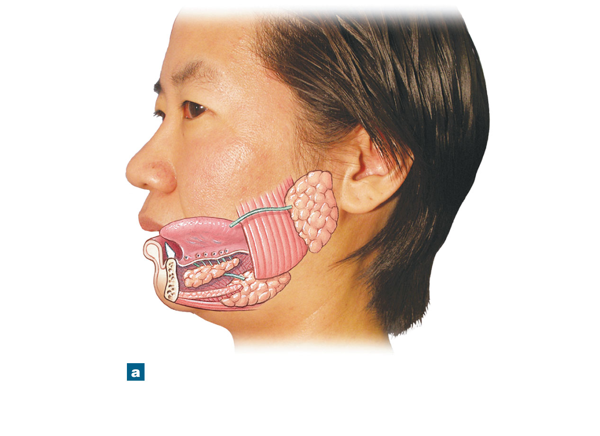
Figure 24-7a The Salivary Glands
Parotid salivary gland
Sublingual salivary gland
Submandibular salivary gland
A lateral view, showing the relative positions of the salivary glands and ducts on the left side of the head.
Notes:
9

Slide 10
24-2 The Oral Cavity
Saliva
99.4% water
0.6% includes:
Electrolytes (Na⁺, Cl⁻, and HCO₃⁻)
Buffers
Glycoproteins (mucins)
Antibodies
Enzymes
Waste products

Slide 11
24-2 The Oral Cavity
Functions of Saliva
Lubricating the mouth
Moistening and lubricating materials in the mouth
Dissolving chemicals that stimulate taste buds and provide sensory information
Initiating digestion of complex carbohydrates by the enzyme salivary amylase (ptyalin or alpha-amylase)

Slide 12
24-2 The Oral Cavity
The Teeth
Tongue movements pass food across occlusal surfaces of teeth
Chew (masticate) food

Slide 13
24-2 The Oral Cavity
Dentin
A mineralized matrix similar to that of bone
Does not contain cells
Pulp Cavity
Receives blood vessels and nerves through the root canal
Root
Of each tooth sits in a bony socket (alveolus)
A layer of cementum covers dentin of the root
Providing protection and anchoring periodontal ligament
Crown
Exposed portion of tooth
Projects beyond soft tissue of gingiva
Dentin covered by layer of enamel

Slide 14
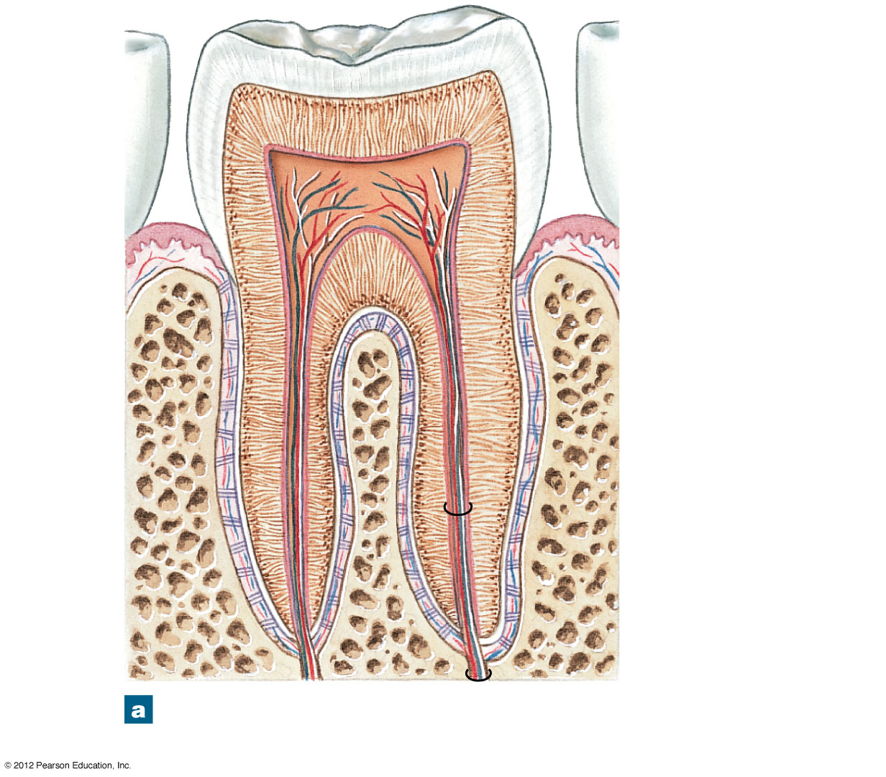
Figure 24-8a Teeth
Enamel
Crown
Dentin
Pulp cavity
Gingiva
Neck
Cementum
Periodontal ligament
Root
Root canal
Bone of alveolus
A diagrammatic section through a typical adult tooth.
Notes:
14

Slide 15
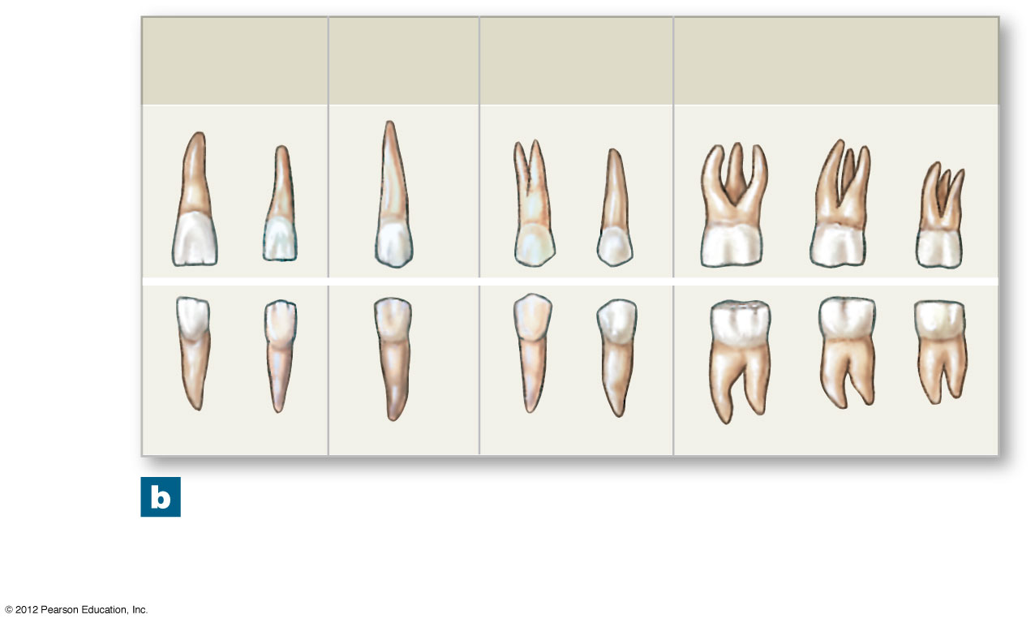
Figure 24-8b Teeth
Incisors
Cuspids (canines)
Bicuspids (premolars)
Molars
Upper jaw
Lower jaw
The adult teeth from the right side of the upper and lower jaws. Figure 24-9a,b provides a view of the occlusal surfaces.
Notes:
15

Slide 16
24-2 The Oral Cavity
Types of Teeth
Incisors
Cuspids (canines)
Bicuspids (premolars)
Molars

Slide 17
24-2 The Oral Cavity
Incisors
Blade-shaped teeth
Located at front of mouth
Used for clipping or cutting

Slide 18
24-2 The Oral Cavity
Cuspids (Canines)
Conical
Sharp ridgeline
Pointed tip
Used for tearing or slashing

Slide 19
24-2 The Oral Cavity
Bicuspids (Premolars)
Flattened crowns
Prominent ridges
Used to crush, mash, and grind

Slide 20
24-2 The Oral Cavity
Molars
Very large, flat crowns
With prominent ridges
Used for crushing and grinding

Slide 21
24-2 The Oral Cavity
Dental Succession
During embryonic development, two sets of teeth form
Primary dentition, or deciduous teeth
Secondary dentition, or permanent dentition

Slide 22
24-2 The Oral Cavity
Deciduous Teeth
Also called primary teeth, milk teeth, or baby teeth
20 temporary teeth of primary dentition
Five on each side of upper and lower jaws
2 incisors
1 cuspid
2 deciduous molars

Slide 23
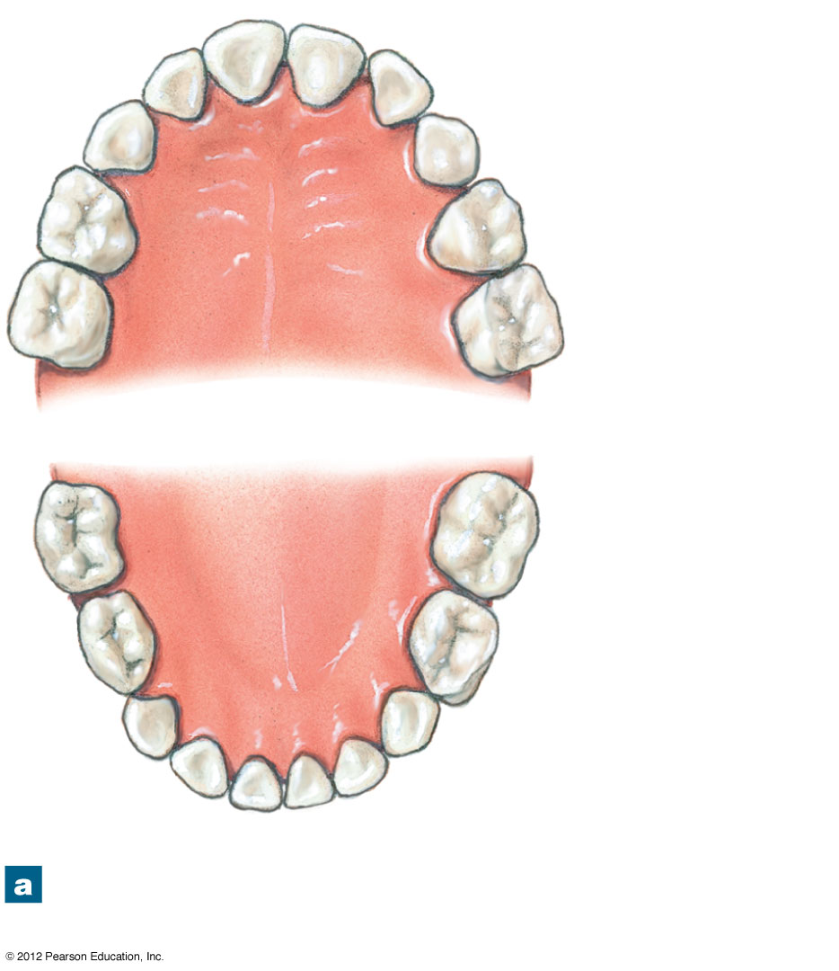
Figure 24-9a Primary and Secondary Dentitions
Central incisors (7.5 mo)
Lateral incisor (9 mo)
Cuspid (18 mo)
Deciduous 1st molar (14 mo)
Deciduous 2nd molar (24 mo)
Deciduous 2nd molar (20 mo)
Deciduous 1st molar (12 mo)
Cuspid (16 mo)
Lateral incisor (7 mo)
Central incisors (6 mo)
The primary teeth, with the age at eruption given in months.
Notes:
23

Slide 24
24-2 The Oral Cavity
Secondary Dentition
Also called permanent dentition
Replaces deciduous teeth
32 permanent teeth
Eight on each side, upper and lower
2 incisors
1 cuspid
5 molars

Slide 25
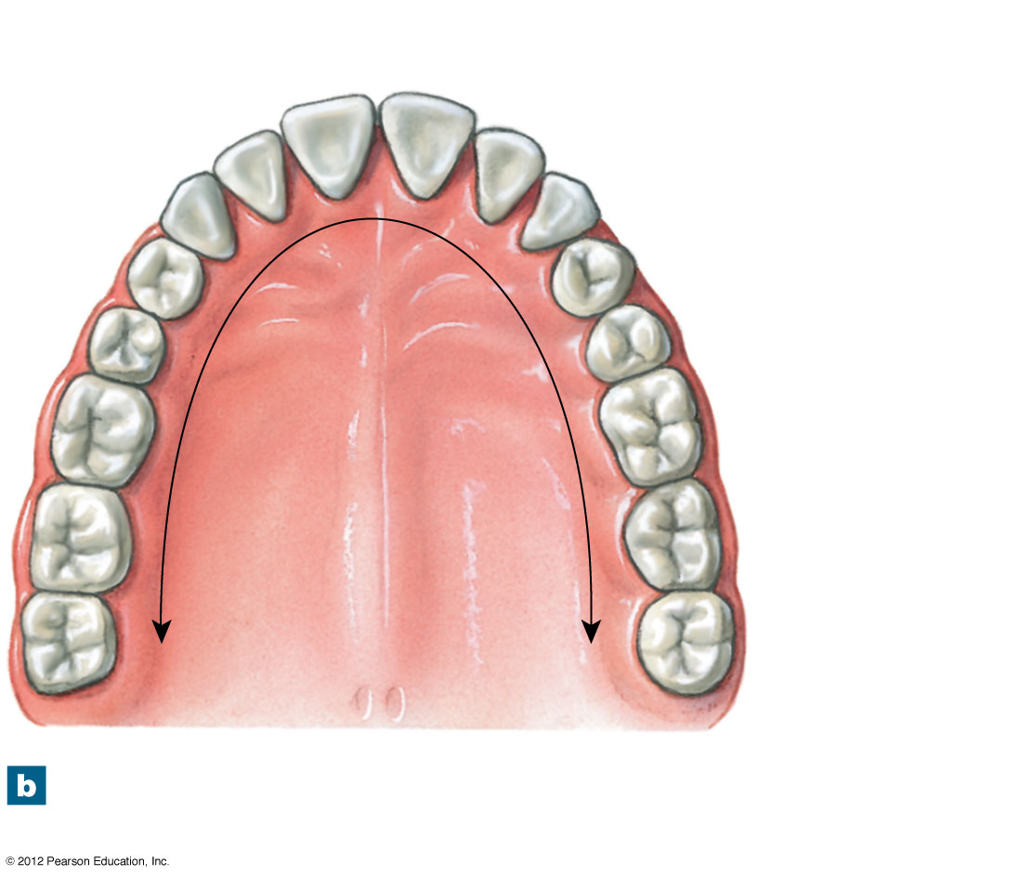
Figure 24-9b Primary and Secondary Dentitions
Central incisors (7–8 yr)
Lateral incisor (8–9 yr)
Cuspid (11–12 yr)
1st Premolar (10–11 yr)
Maxillary dental arcade
2nd Premolar (10–12 yr)
1st Molar (6–7 yr)
2nd Molar (12–13 yr)
Hard palate
3rd Molar (17–21 yr)
The adult teeth, with the age at eruption given in years.
Notes:
25

Slide 26
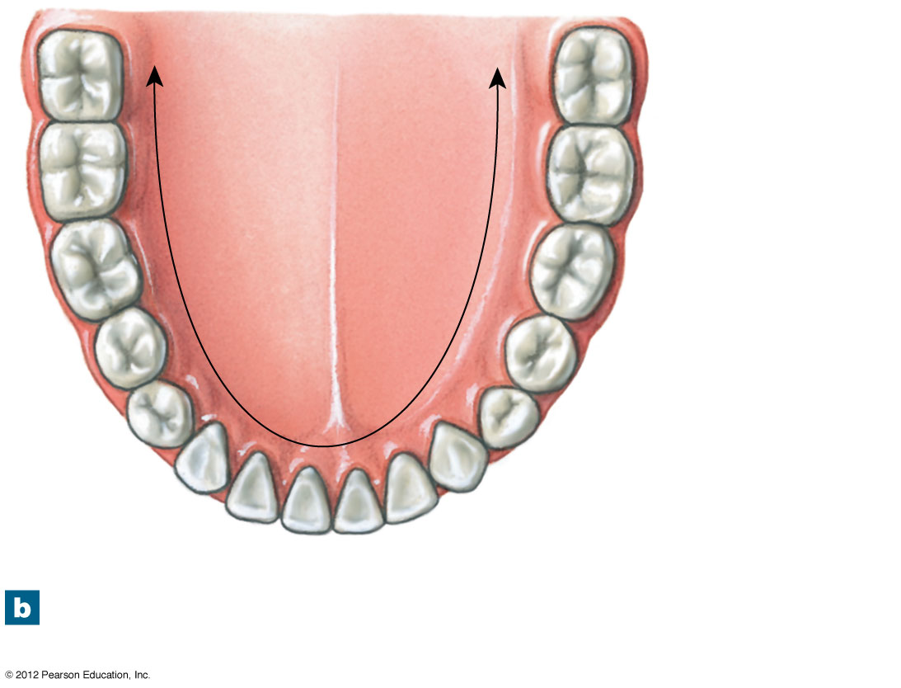
Figure 24-9b Primary and Secondary Dentitions
3rd Molar (17–21 yr)
2nd Molar (11–13 yr)
1st Molar (6–7 yr)
Mandibular dental arcade
2nd Premolar (11–12 yr)
1st Premolar (10–12 yr)
Cuspid (9–10 yr)
Lateral incisor (7–8 yr)
Central incisors (6–7 yr)
The adult teeth, with the age at eruption given in years.
Notes:
26

Slide 27
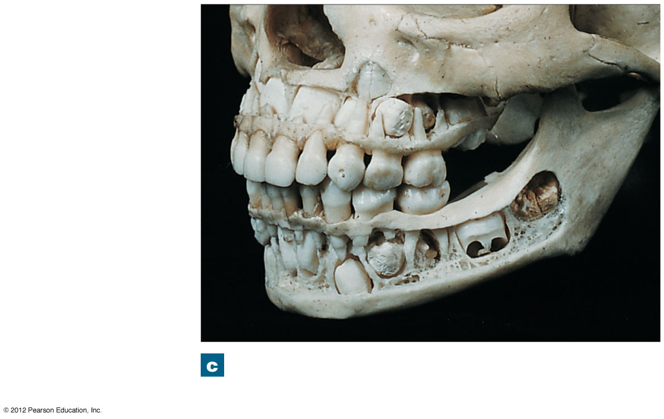
Figure 24-9c Primary and Secondary Dentitions
Maxilla exposed to show developing permanent teeth
Erupted deciduous teeth
First and second molars
Mandible exposed to show developing permanent teeth
Maxilla and mandible with unerupted teeth exposed.
Notes:
27

Slide 28
24-2 The Oral Cavity
Mastication
Also called chewing
Food is forced from oral cavity to vestibule and back
Crossing and recrossing occlusal surfaces
Muscles of Mastication
Close the jaws
Slide or rock lower jaw from side to side

