Slide 1
12-2 Neurons
Neurons
The basic functional units of the nervous system
The structure of neurons
The multipolar neuron
Common in the CNS
Cell body (soma)
Short, branched dendrites
Long, single axon

Slide 2
12-2 Neurons
The Cell Body
Large nucleus and nucleolus
Mitochondria (produce energy)
RER and ribosomes (produce neurotransmitters)

Slide 3
12-2 Neurons
The Cell Body
Cytoskeleton
Neurofilaments and neurotubules in place of microfilaments and microtubules
Neurofibrils: bundles of neurofilaments that provide support for dendrites and axon
Nissl bodies
Dense areas of RER and ribosomes
Make neural tissue appear gray (gray matter)

Slide 4
12-2 Neurons
Dendrites
Highly branched
Dendritic spines
Many fine processes
Receive information from other neurons
80–90% of neuron surface area

Slide 5
12-2 Neurons
The axon
Is long
Carries electrical signal (action potential) to target
Axon structure is critical to function

Slide 6
12-2 Neurons
Structures of the Axon
Axoplasm
Cytoplasm of axon
Contains neurofibrils, neurotubules, enzymes, organelles
Axolemma
Specialized cell membrane
Covers the axoplasm

Slide 7
12-2 Neurons
Structures of the Axon
Axon hillock
Thick section of cell body
Attaches to initial segment
Synaptic terminals
Tips of axon

Slide 8
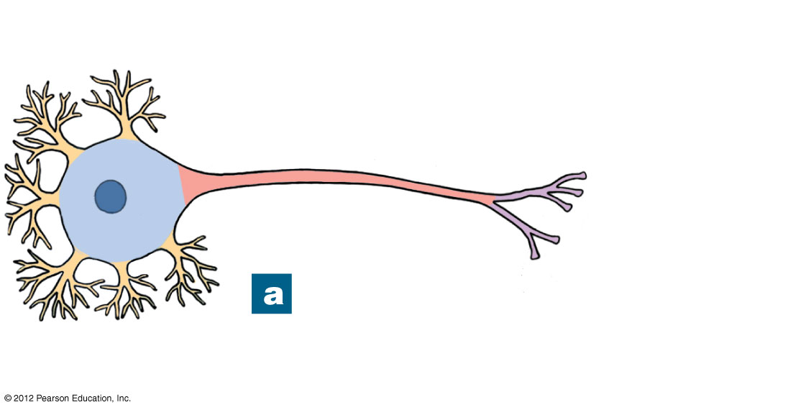
Figure 12-1a The Anatomy of a Multipolar Neuron
Dendrites
Perikaryon
Cell body
Nucleus
Telodendria
Axon
This color-coded figure
shows the four general
regions of a neuron.
Notes:
8

Slide 9
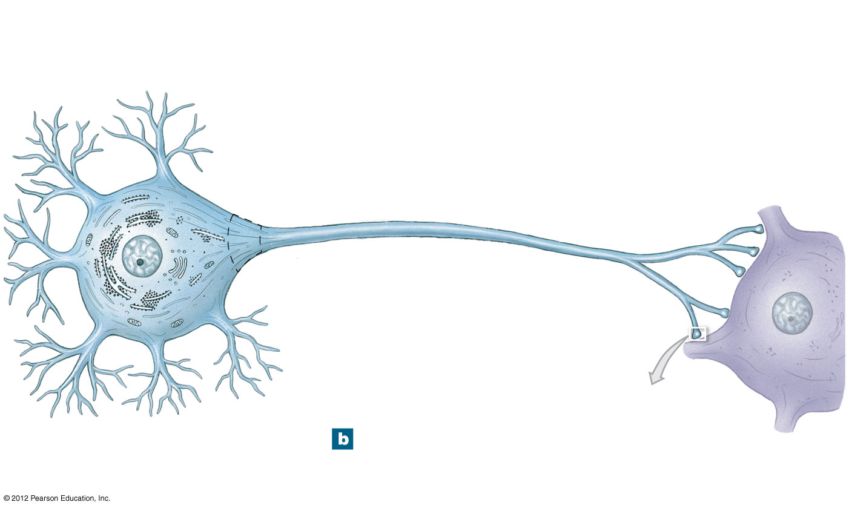
Figure 12-1b The Anatomy of a Multipolar Neuron
Dendritic branches
Nissl bodies (RER
and free ribosomes)
Mitochondrion
Axon hillock
Initial segment
of axon
Axolemma
Telodendria
Golgi apparatus
Axon
Neurofilament
Synaptic
terminals
Nucleus
Nucleolus
Dendrite
See Figure 12–2
PRESYNAPTIC CELL
An understanding of neuron
function requires knowing its
structural components.
POSTSYNAPTIC
CELL
Notes:
9

Slide 10
12-2 Neurons
The Structure of Neurons
The synapse
Area where a neuron communicates with another cell
Presynaptic cell
Neuron that sends message
Postsynaptic cell
Cell that receives message
The synaptic cleft
The small gap that separates the presynaptic membrane and the postsynaptic membrane

Slide 11
12-2 Neurons
The Synapse
The synaptic terminal
Is expanded area of axon of presynaptic neuron
Contains synaptic vesicles of neurotransmitters
Neurotransmitters
Are chemical messengers
Are released at presynaptic membrane
Affect receptors of postsynaptic membrane
Are broken down by enzymes

Slide 12
12-2 Neurons
Types of Synapses
Neuromuscular junction
Synapse between neuron and muscle
Neuroglandular junction
Synapse between neuron and gland

Slide 13
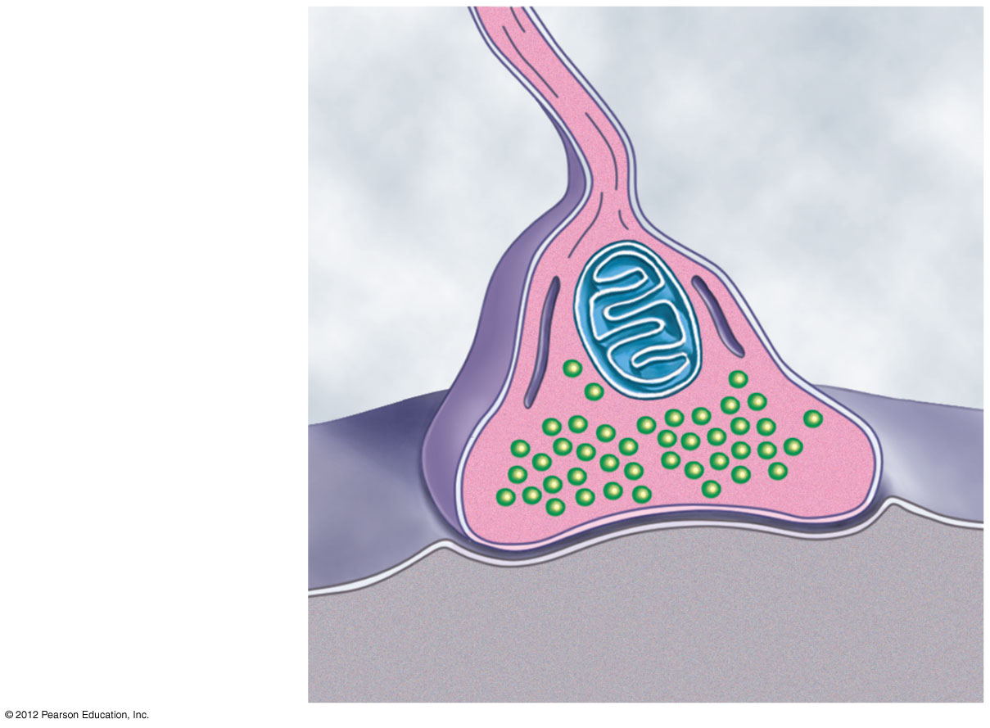
Figure 12-2 The Structure of a Typical Synapse
Telodendrion
Synaptic terminal
Endoplasmic
reticulum
Mitochondrion
Synaptic
vesicles
Presynaptic
membrane
Postsynaptic
membrane
Synaptic
cleft
Notes:
13

Slide 14
12-2 Neurons
Structural Classification of Neurons
Anaxonic neurons
Found in brain and sense organs
Bipolar neurons
Found in special sensory organs (sight, smell, hearing)
Unipolar neurons
Found in sensory neurons of PNS
Multipolar neurons
Common in the CNS
Include all skeletal muscle motor neurons

Slide 15
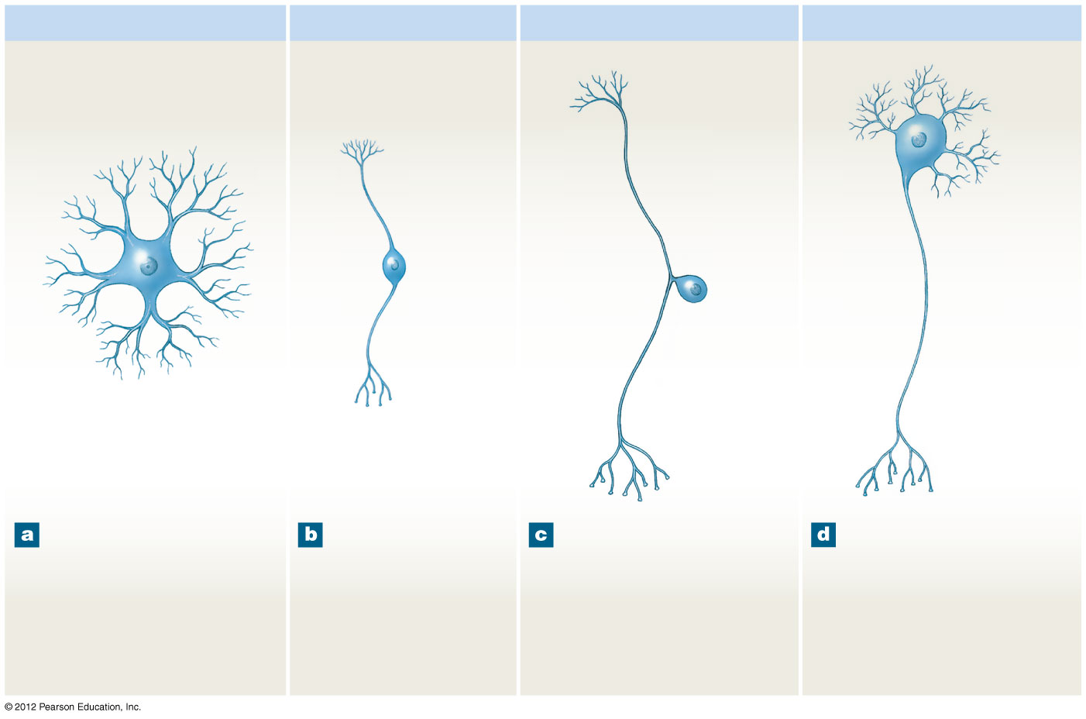
Figure 12-3 A Structural Classification of Neurons
Anaxonic neuron
Bipolar neuron
Unipolar neuron
Multipolar neuron
Dendrites
Dendrites
Initial
segment
Dendritic
branches
Cell
body
Axon
Dendrite
Cell body
Cell
body
Axon
Axon
Cell
body
Synaptic
terminals
Axon
Synaptic
terminals
Synaptic
terminals
Notes:
15

Slide 16
12-2 Neurons
Anaxonic Neurons
Small
All cell processes look alike
Bipolar Neurons
Are small
One dendrite, one axon

Slide 17
Figure 12-3a A Structural Classification of Neurons
Anaxonic neuron
Cell
body
Anaxonic neurons
have more than two
processes, but axons
cannot be
distinguished from
dendrites.
Notes:
17

Slide 18
Figure 12-3b A Structural Classification of Neurons
Bipolar neuron
Dendritic
branches
Dendrite
Cell body
Axon
Synaptic
terminals
Bipolar neurons
have two
processes
separated by the
cell body.
Notes:
18

Slide 19
12-2 Neurons
Unipolar Neurons
Also called pseudounipolar neurons
Have very long axons
Fused dendrites and axon
Cell body to one side
Multipolar Neurons
Have very long axons
Multiple dendrites, one axon

Slide 20
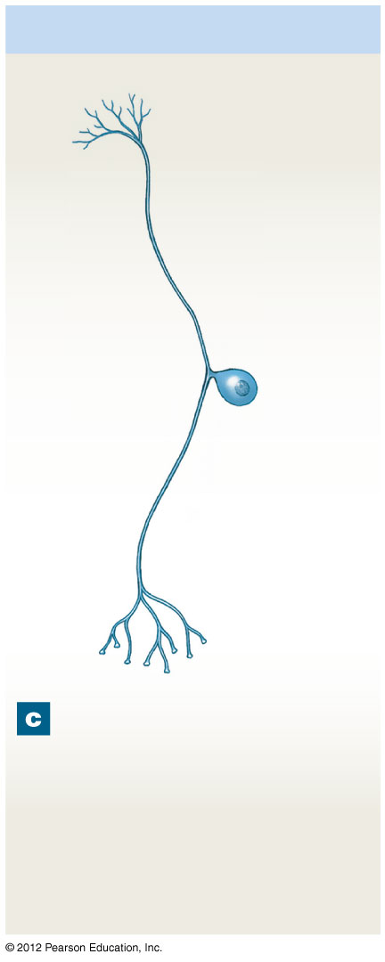
Figure 12-3c A Structural Classification of Neurons
Unipolar neuron
Dendrites
Initial
segment
Axon
Cell
body
Axon
Synaptic
terminals
Unipolar neurons
have a single
elongate process,
with the cell body
situated off to the
side.
Notes:
20

Slide 21
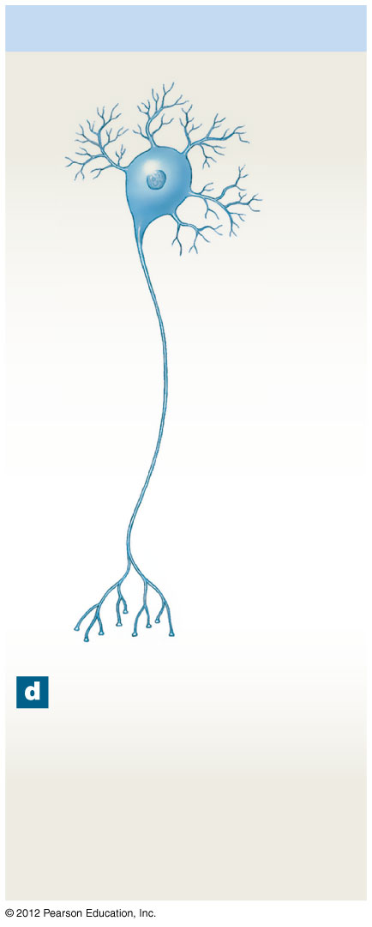
Figure 12-3d A Structural Classification of Neurons
Multipolar neuron
Dendrites
Cell
body
Axon
Synaptic
terminals
Multipolar neurons
have more than two
processes; there is a
single axon and
multiple dendrites.
Notes:
21

Slide 22
12-2 Neurons
Three Functional Classifications of Neurons
Sensory neurons
Afferent neurons of PNS
Motor neurons
Efferent neurons of PNS
Interneurons
Association neurons

Slide 23
12-2 Neurons
Functions of Sensory Neurons
Monitor internal environment (visceral sensory neurons)
Monitor effects of external environment (somatic sensory neurons)

Slide 24
12-2 Neurons
Three Types of Sensory Receptors
Interoceptors
Monitor internal systems (digestive, respiratory, cardiovascular, urinary, reproductive)
Internal senses (taste, deep pressure, pain)
Exteroceptors
External senses (touch, temperature, pressure)
Distance senses (sight, smell, hearing)
Proprioceptors
Monitor position and movement (skeletal muscles and joints)

Slide 25
12-2 Neurons
Motor Neurons
Carry instructions from CNS to peripheral effectors
Via efferent fibers (axons)
Two major efferent systems
Somatic nervous system (SNS)
Includes all somatic motor neurons that innervate skeletal muscles
Autonomic (visceral) nervous system (ANS)
Visceral motor neurons innervate all other peripheral effectors
Smooth muscle, cardiac muscle, glands, adipose tissue

Slide 26
12-2 Neurons
Interneurons
Most are located in brain, spinal cord, and autonomic ganglia
Between sensory and motor neurons
Are responsible for:
Distribution of sensory information
Coordination of motor activity
Are involved in higher functions
Memory, planning, learning

